Slide 1

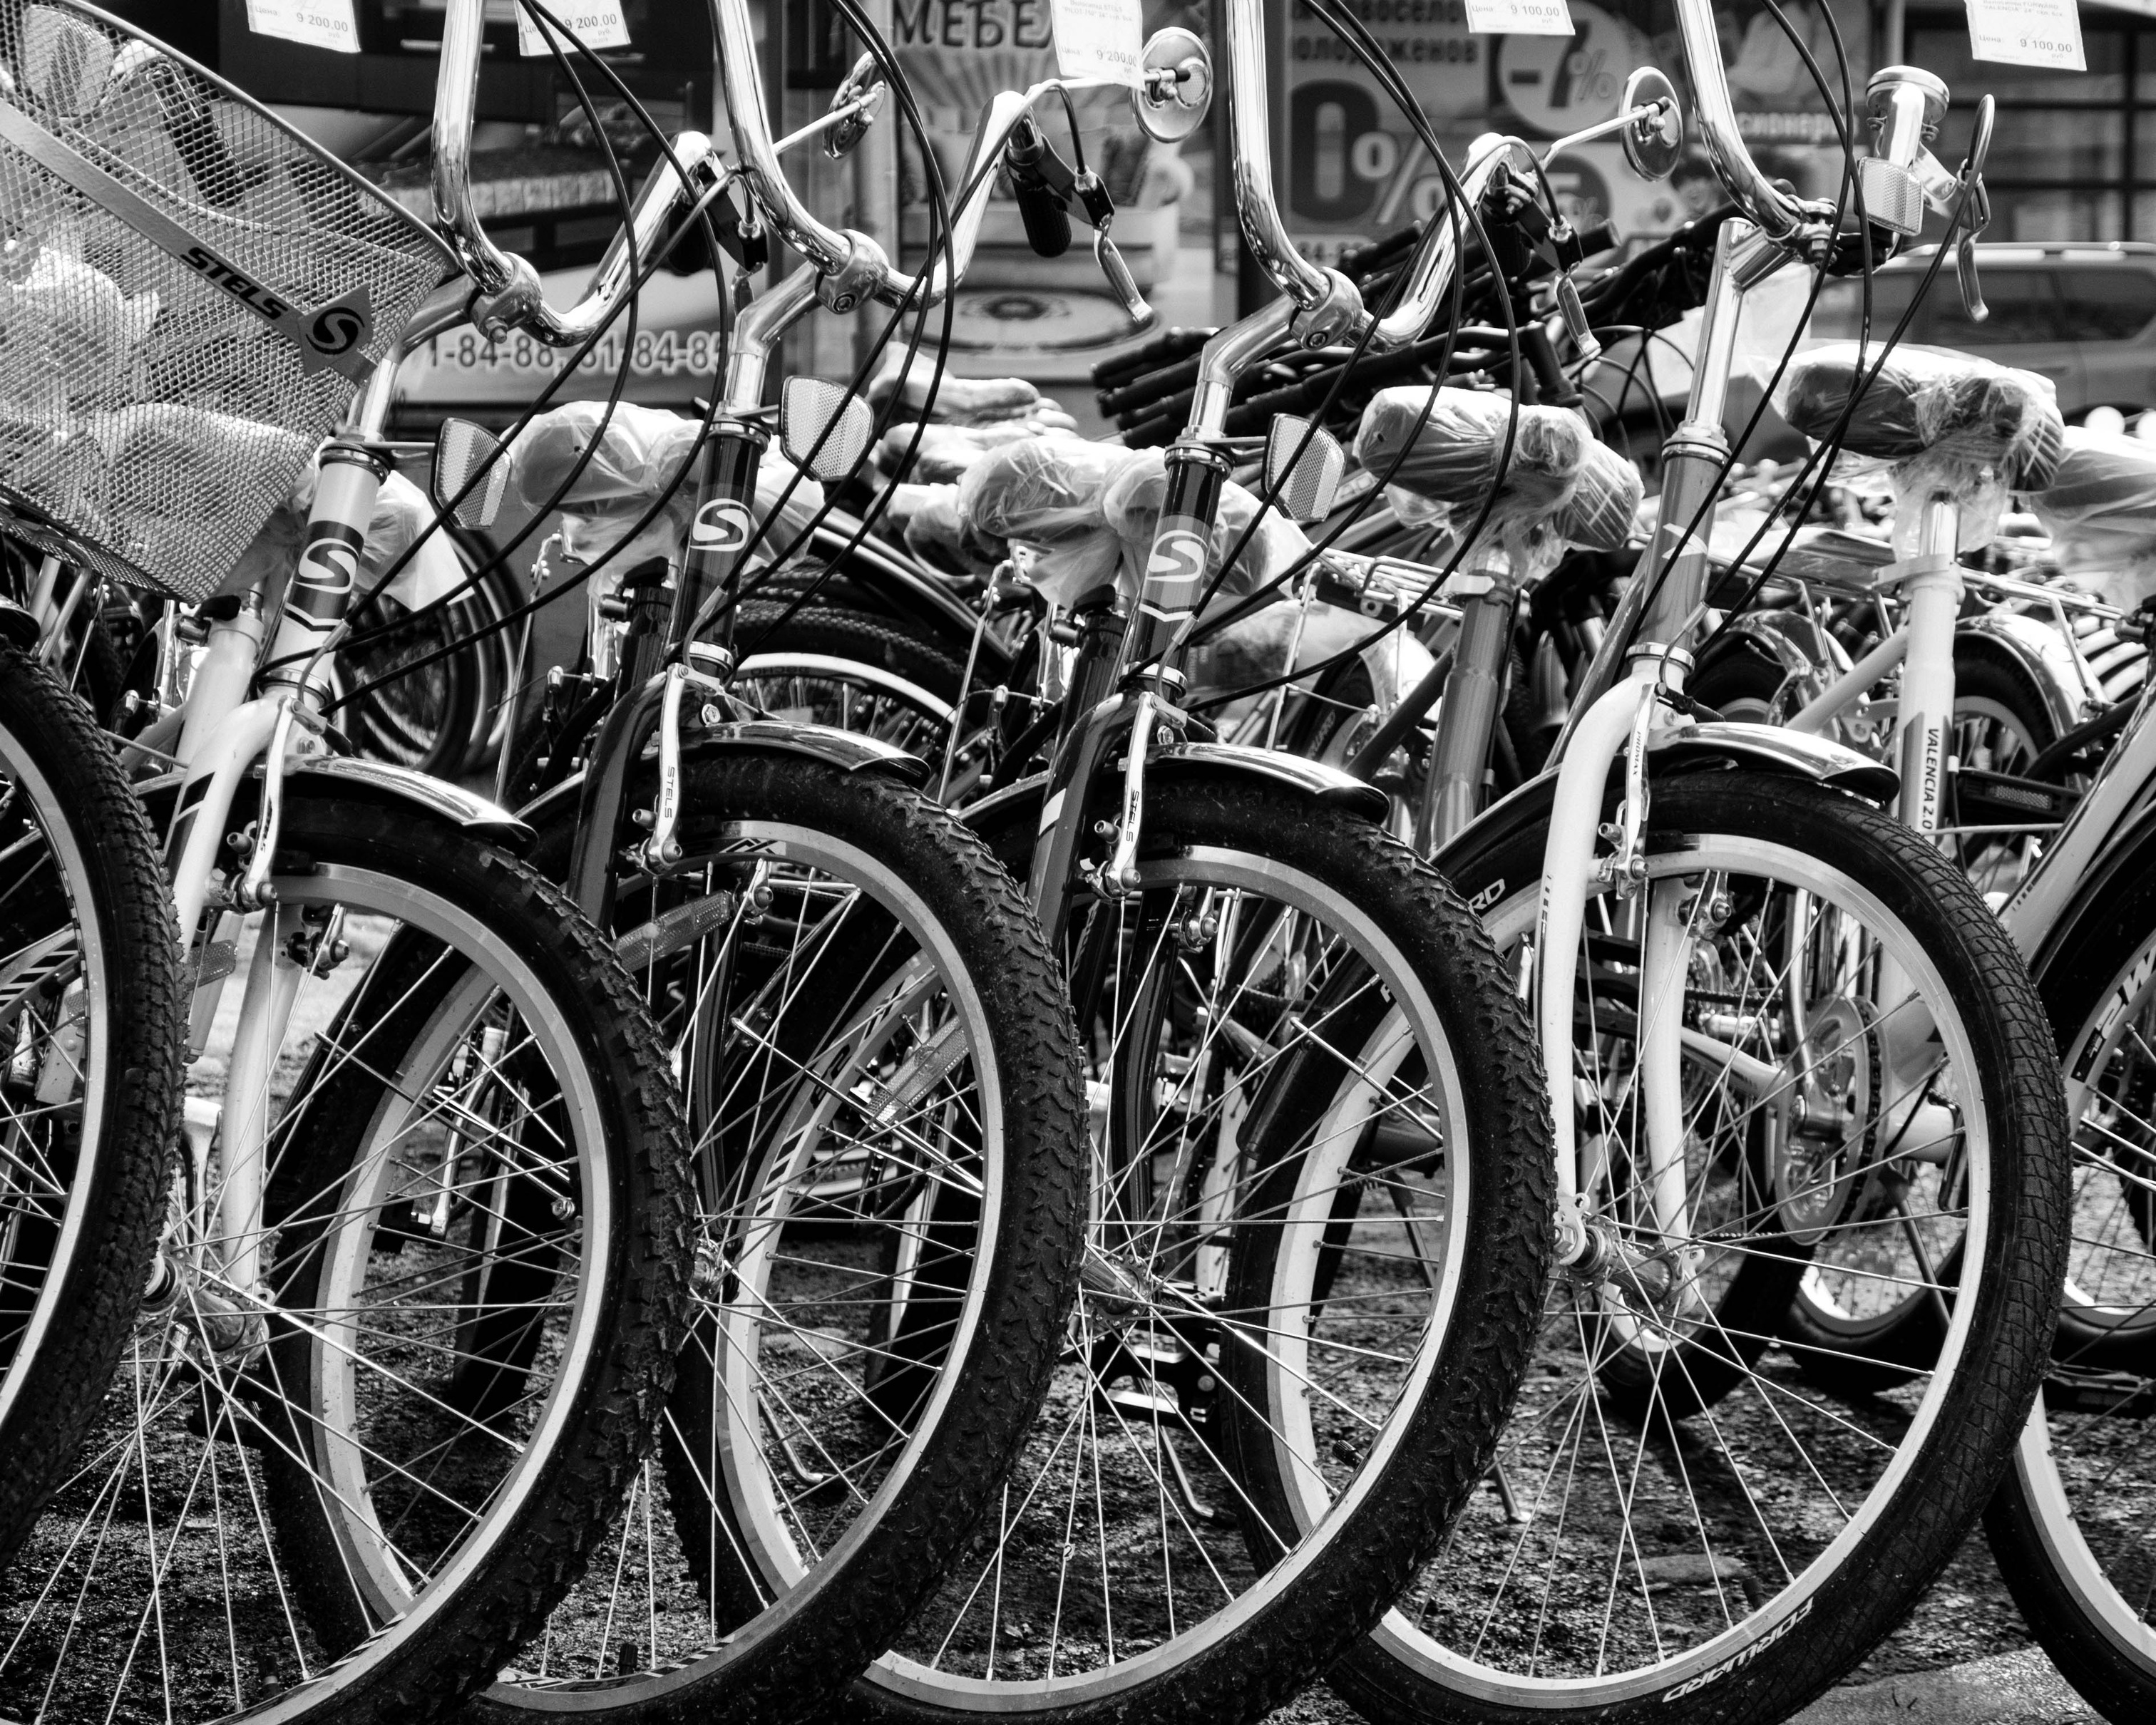





International Conference
on the Two-Wheels
Sector in Europe:
Present and Future
Amílcar Ramalho
Universidade de Coimbra
Organization:
Partners:
More info: https://recuperarportugal.gov.pt/

Slide 2



University of
Coimbra
414
Degrees
30 308
Students
1 823
Professors
349
Researchers
398
Technical Staff
315
Research Fellows
4
Campi
12
Organic Units
16
Libraries
2
Museums
1
Theatre
2
Sports stadiums
1
Botanical Garden
13
Residences
22 671
Publications in Web of Science 2019-2023
399
National and international patents
91
Spin-off
5871
Students of foreign nationality
1 125
International students
787
Outgoing students
1 607
Incoming students
126
Nationalities
1 878
Cooperation agreements
16
Food units
450
Research projects
38
Research Units

Slide 3


UC Strengths
History
Culture
Innovation and Entrepreneurship
Sports
Sustainable Development
UNESCO World Heritage Site
UC Spaces
  BGUC - General Library
  AUC - Archives
  IUC - Press
  MCUC - Science Museum
  CD25A - 25 April Documentation Centre
  TAGV - Gil Vicente Academic Theatre
  EU - University Stadium
  BCSUC - Health Sciences Library
  JBUC - Botanical Garden

Slide 4
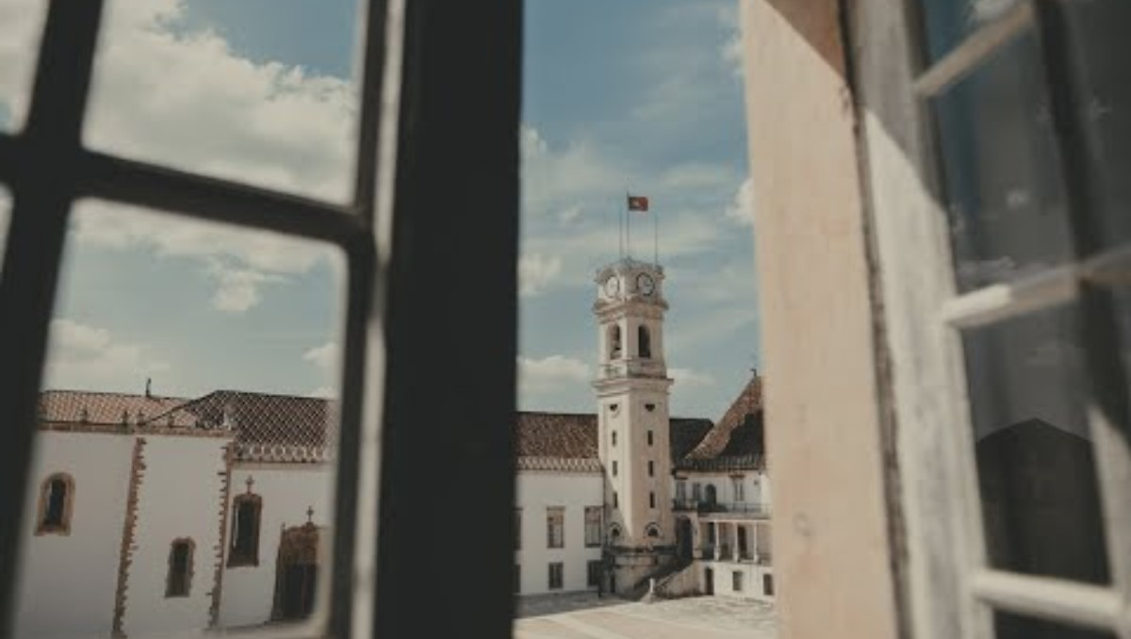

Slide 5
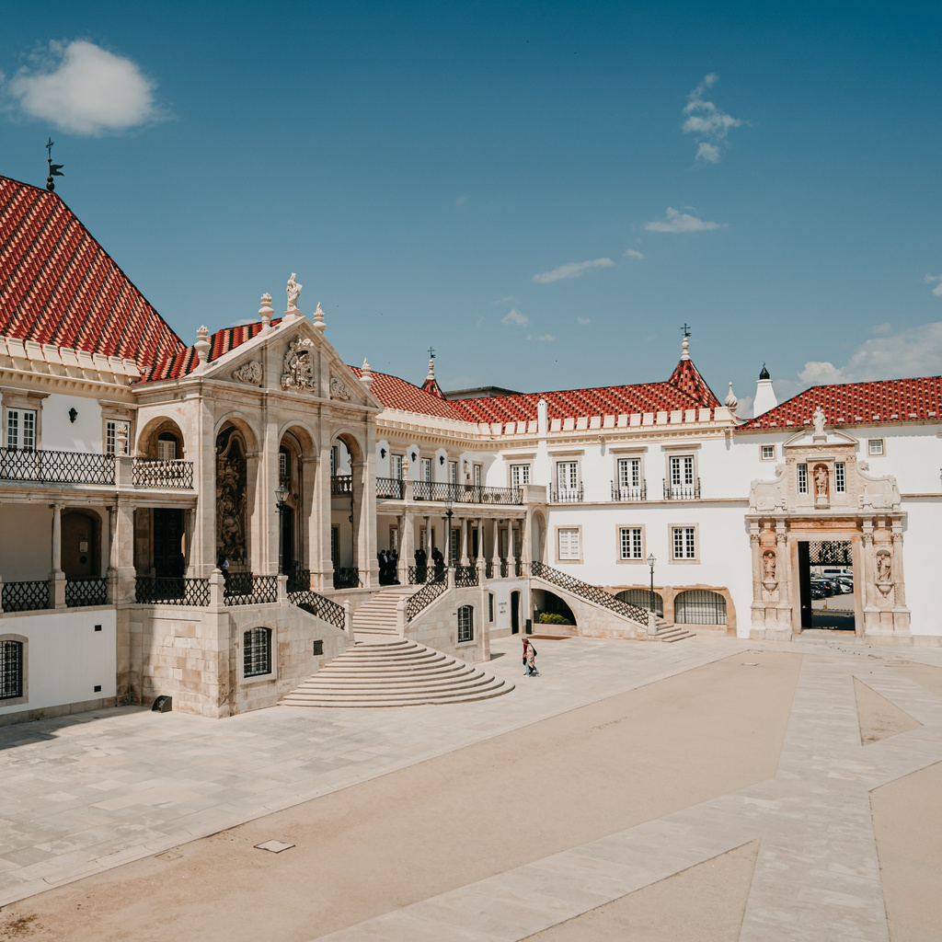
University of
Coimbra
8
Faculties
FLUC
FDUC
FMUC
FCTUC
FFUC
FEUC
FPCEUC
FCDEFUC

Slide 6
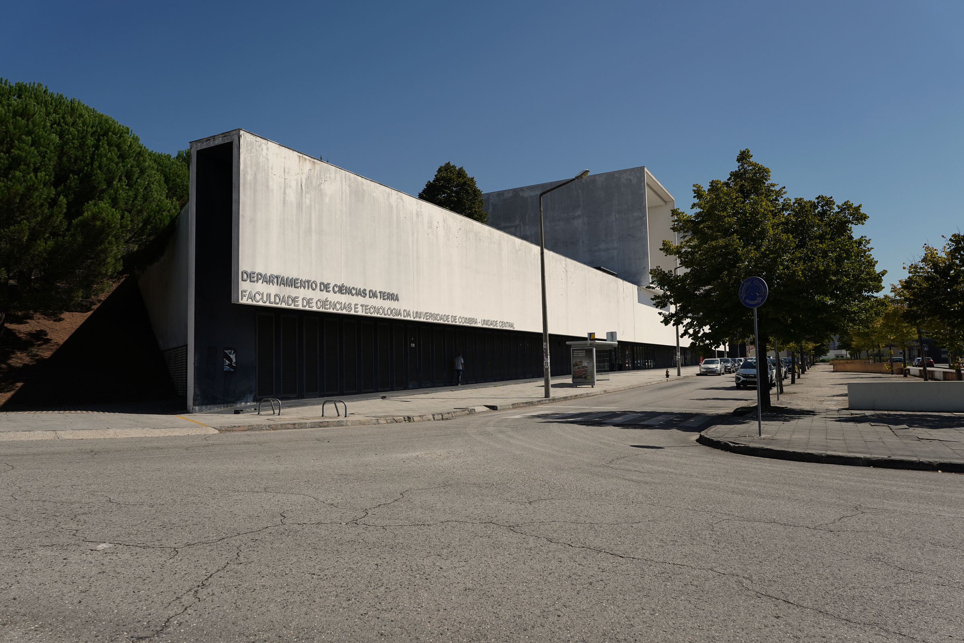

FACULTY OF SCIENCE AND TECHNOLOGY OF THE UNIVERSITY OF COIMBRA

Slide 7

11
Departments
  Department of Architecture
  Department of Earth Sciences
  Department of Life Sciences
  Department of Civil Engineering
  Department of Electrical and Computer Engineering
  Department of Informatics Engineering
  Department of Mechanical Engineering
  Department of Chemical Engineering
  Department of Physics
  Department of Mathematics
  Department of Chemistry

Slide 8
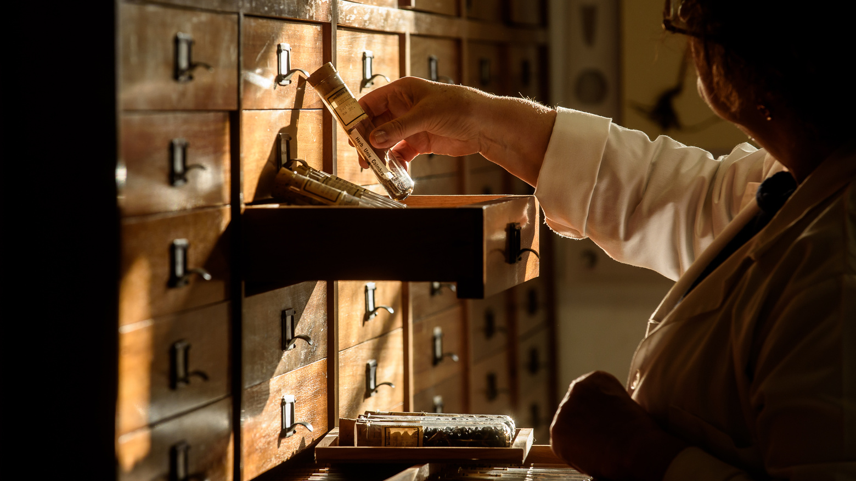
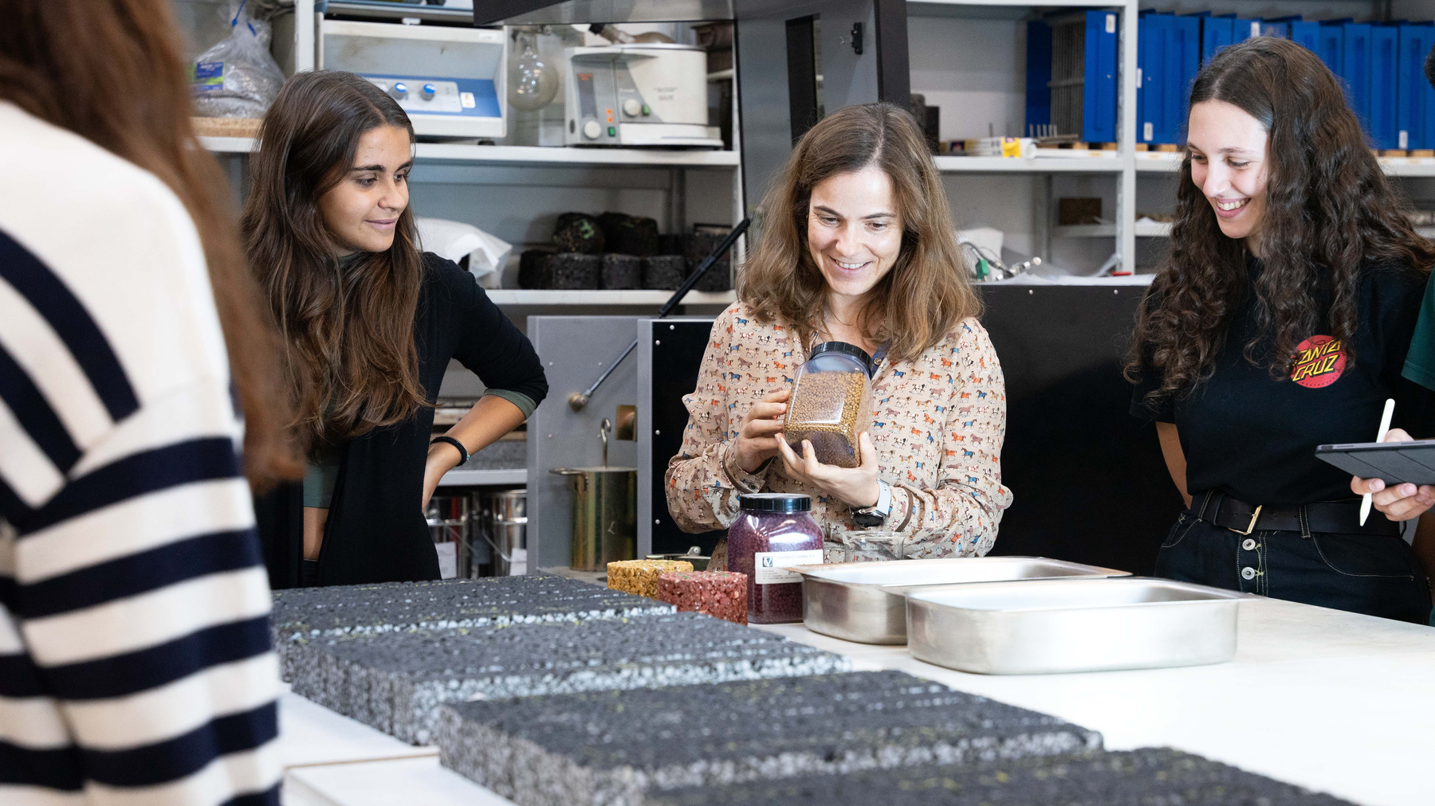
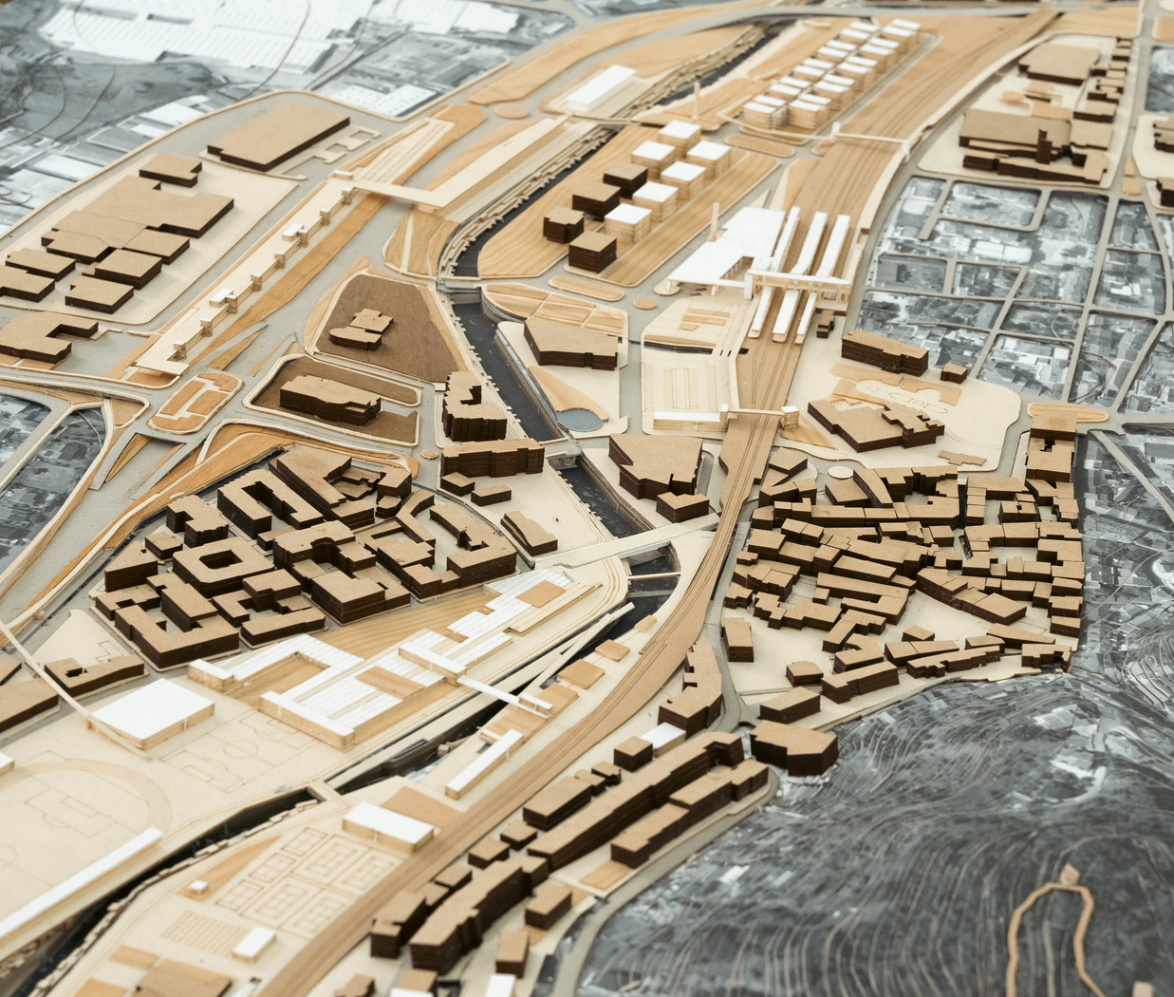
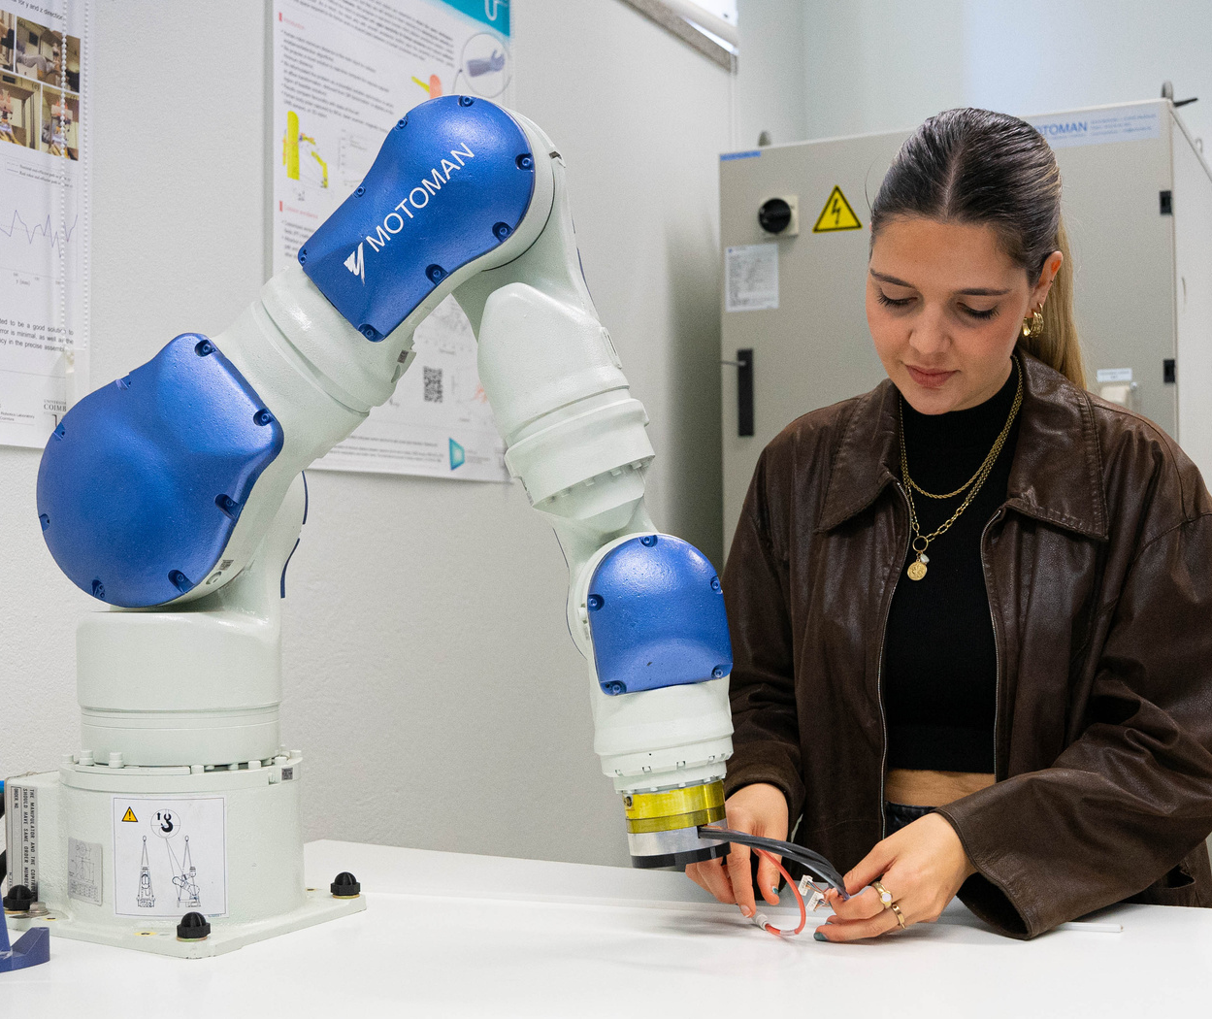
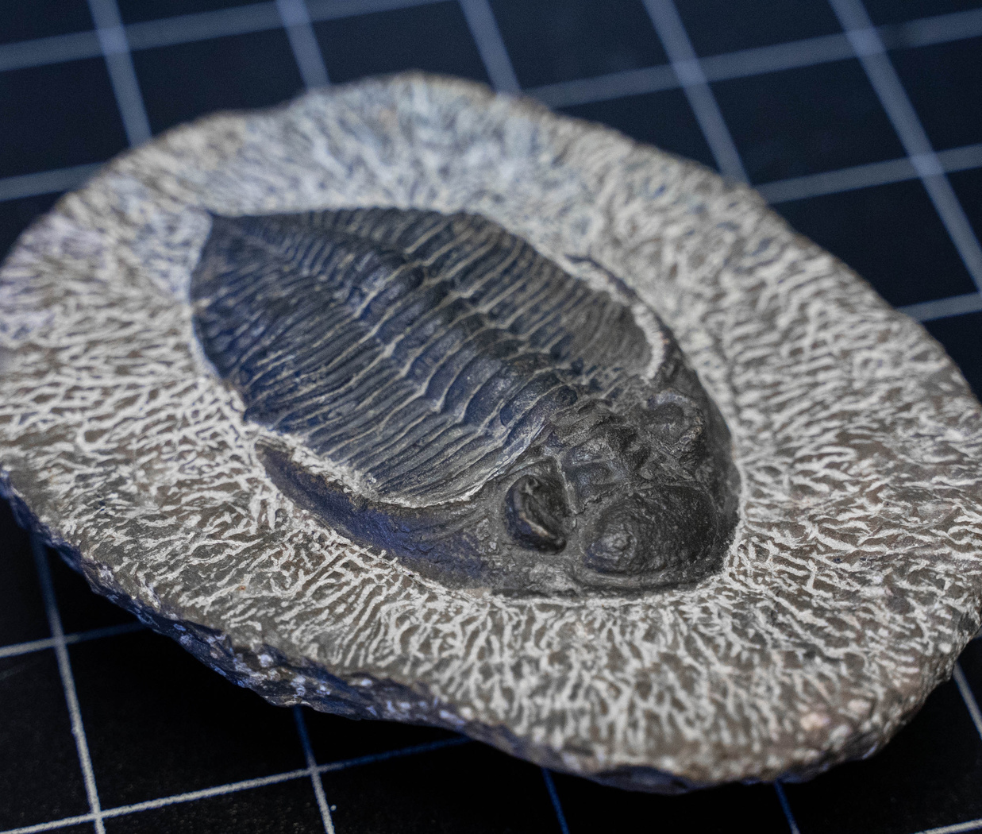

Slide 9
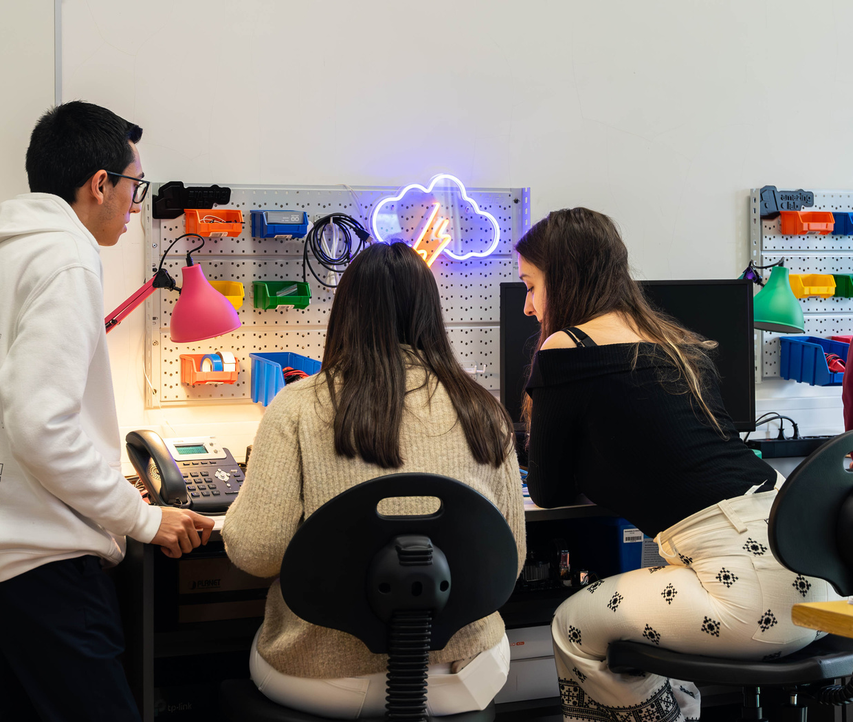
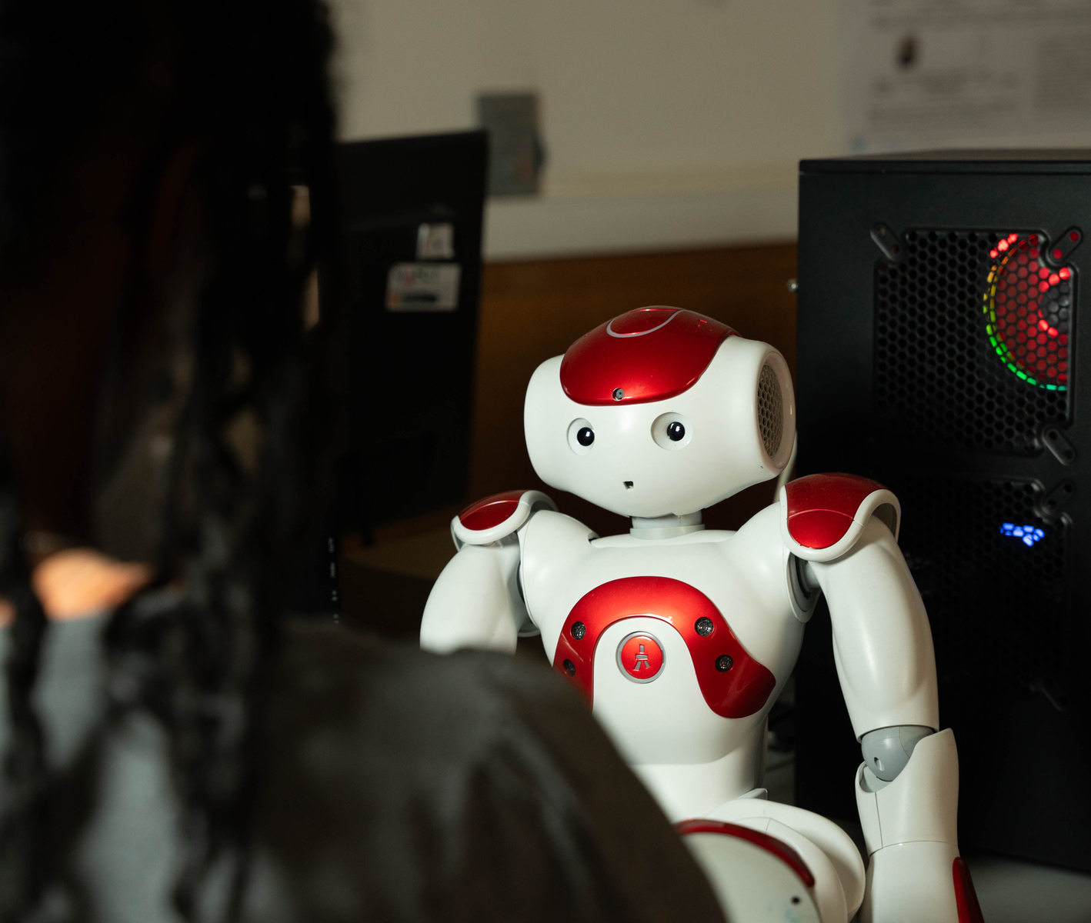
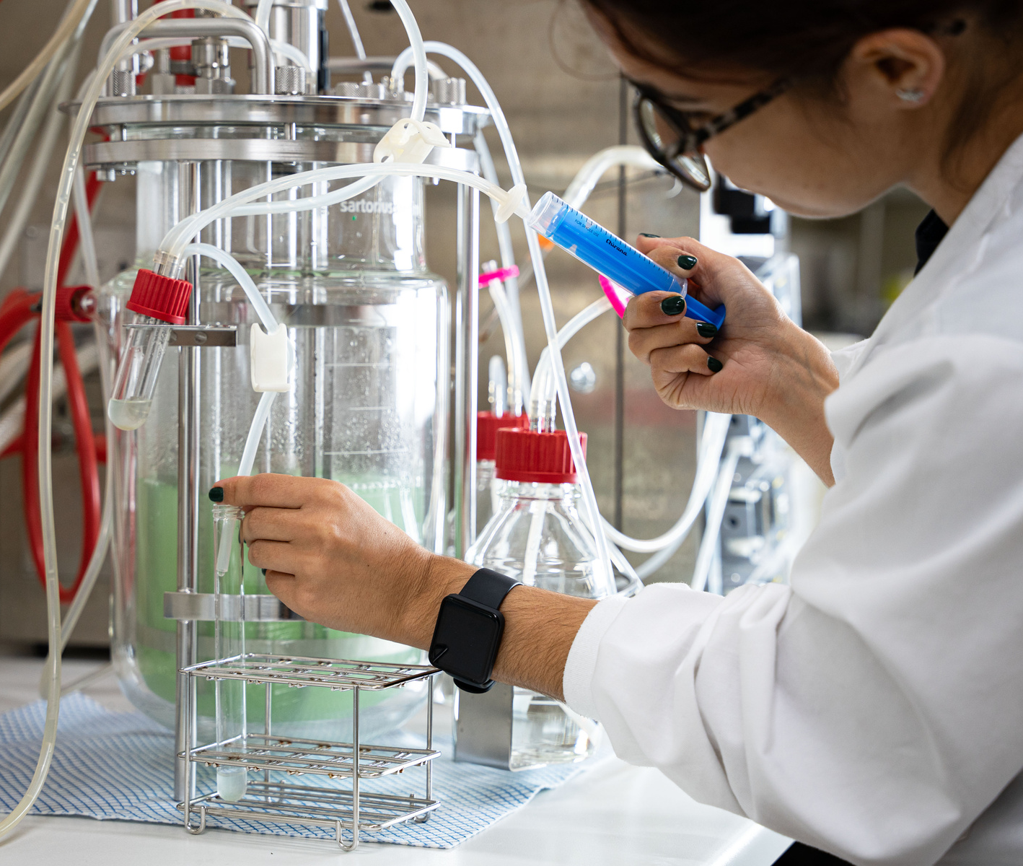
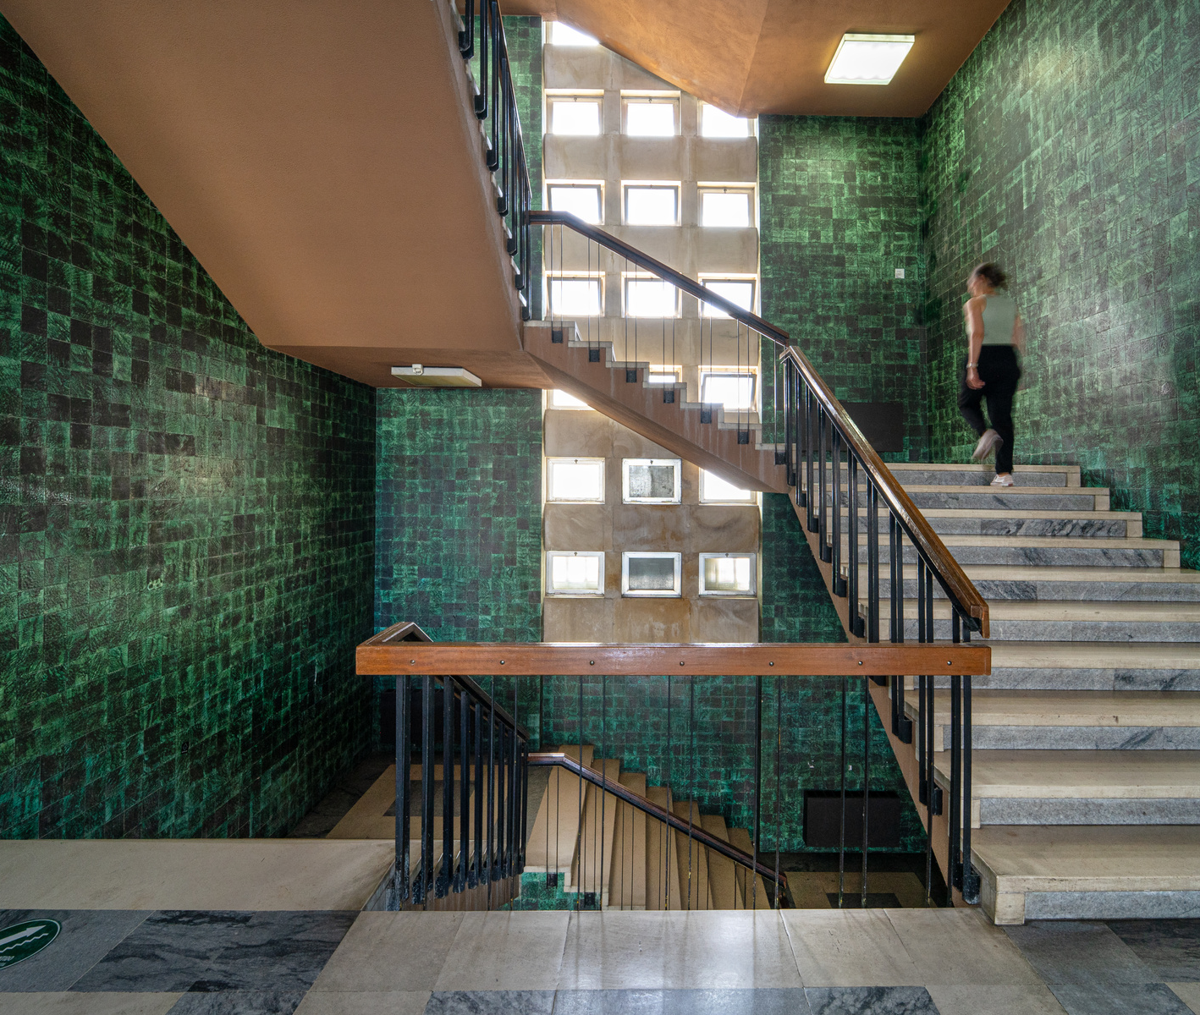
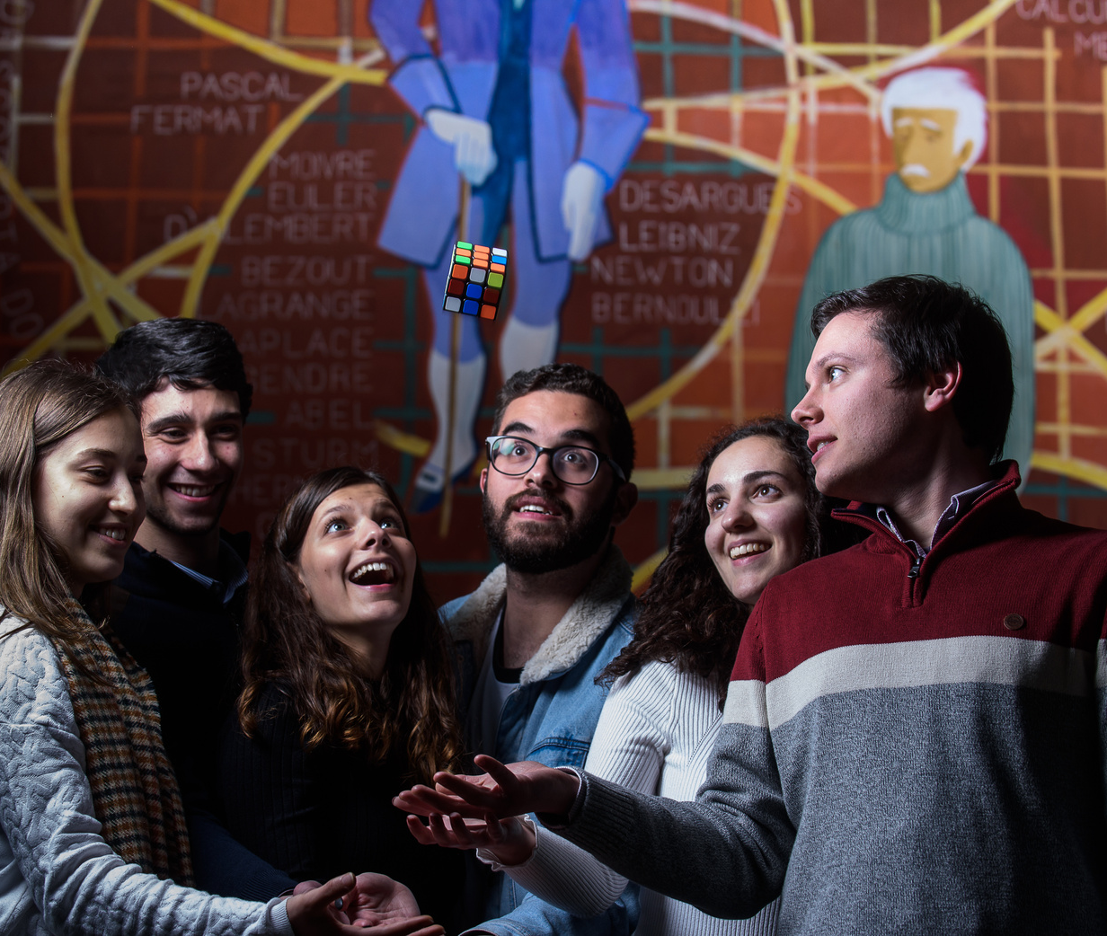
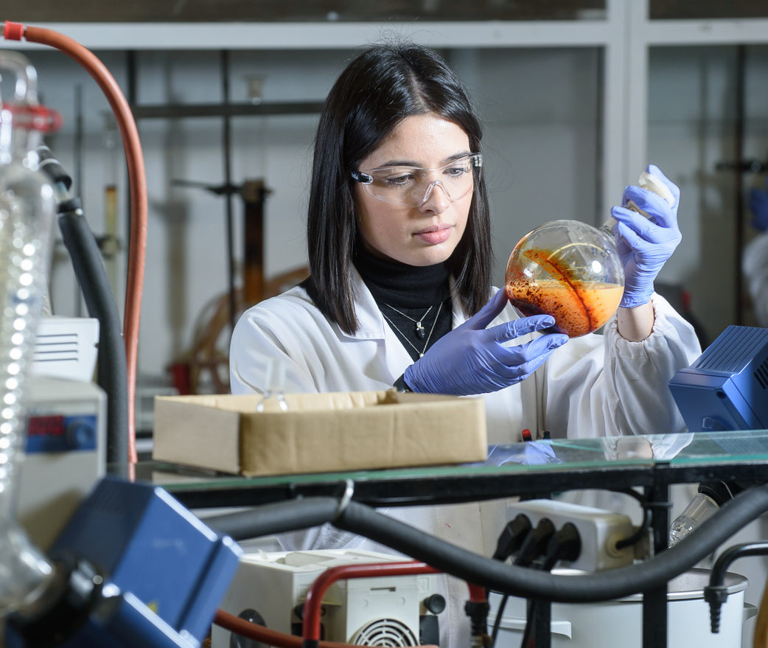

Slide 10

18
Integrated Research Units
  Centre for Functional Ecology - Science for People & the Planet
  Centre for Mechanical Engineering, Materials and Processes
  Chemical Processes and Forest Products Engineering Research Centre
  Physics Centre of the University of Coimbra
  Geoscience Center
  Centre for Research in Anthropology and Health
  Centre for Informatics and Systems of the University of Coimbra
  Centre for Earth and Space Research of the University of Coimbra
  Research Centre for Territory, Transport and Environment
  Centre for Mathematics of the University of Coimbra
  Coimbra Chemistry Centre
  Institute of Astrophysics and Space Sciences
  Institute for sustainability and innovation in structural engineering
  Laboratory for Instrumentation, Biomedical Engineering and Radiation Physics
  Marine and Environmental Sciences Centre
  Molecular Physical-Chemistry Research and Development Unit
  Centre of Architectural Studies from Territory to Design
  Dom Luiz Institute

Slide 11















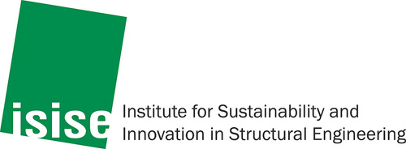


INTEGRATED RESEARCH UNITS
87.5% of FCT evaluations: Excellent (A) and Very Good (B)

Slide 12

8
Associated Research Units
  Association For Development of Industrial Aerodynamics
  Centre for Social Studies
  Centre for Innovative Biomedicine and Biotechnology
  Anthropology Research Network Centre
  Coimbra Institute of Systems and Computer Engineering
  Institute of Systems and Robotics
  Telecommunications Institute
  Instrumentation and Experimental Particle Physics Laboratory

Slide 13


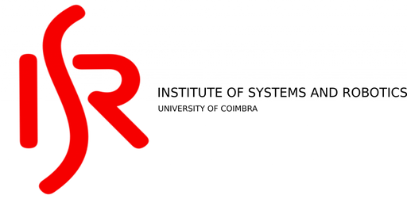





ASSOCIATED RESEARCH UNITS

Slide 14
8635
Students
594
Professors
200
Researchers
149
Non-teaching staff

Slide 15
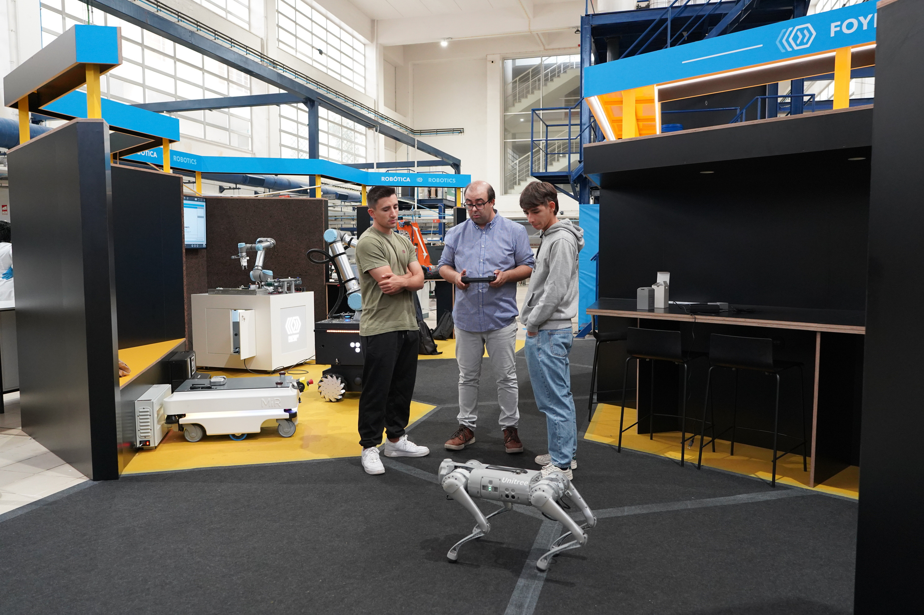


UC FACTORY LAB

Slide 16
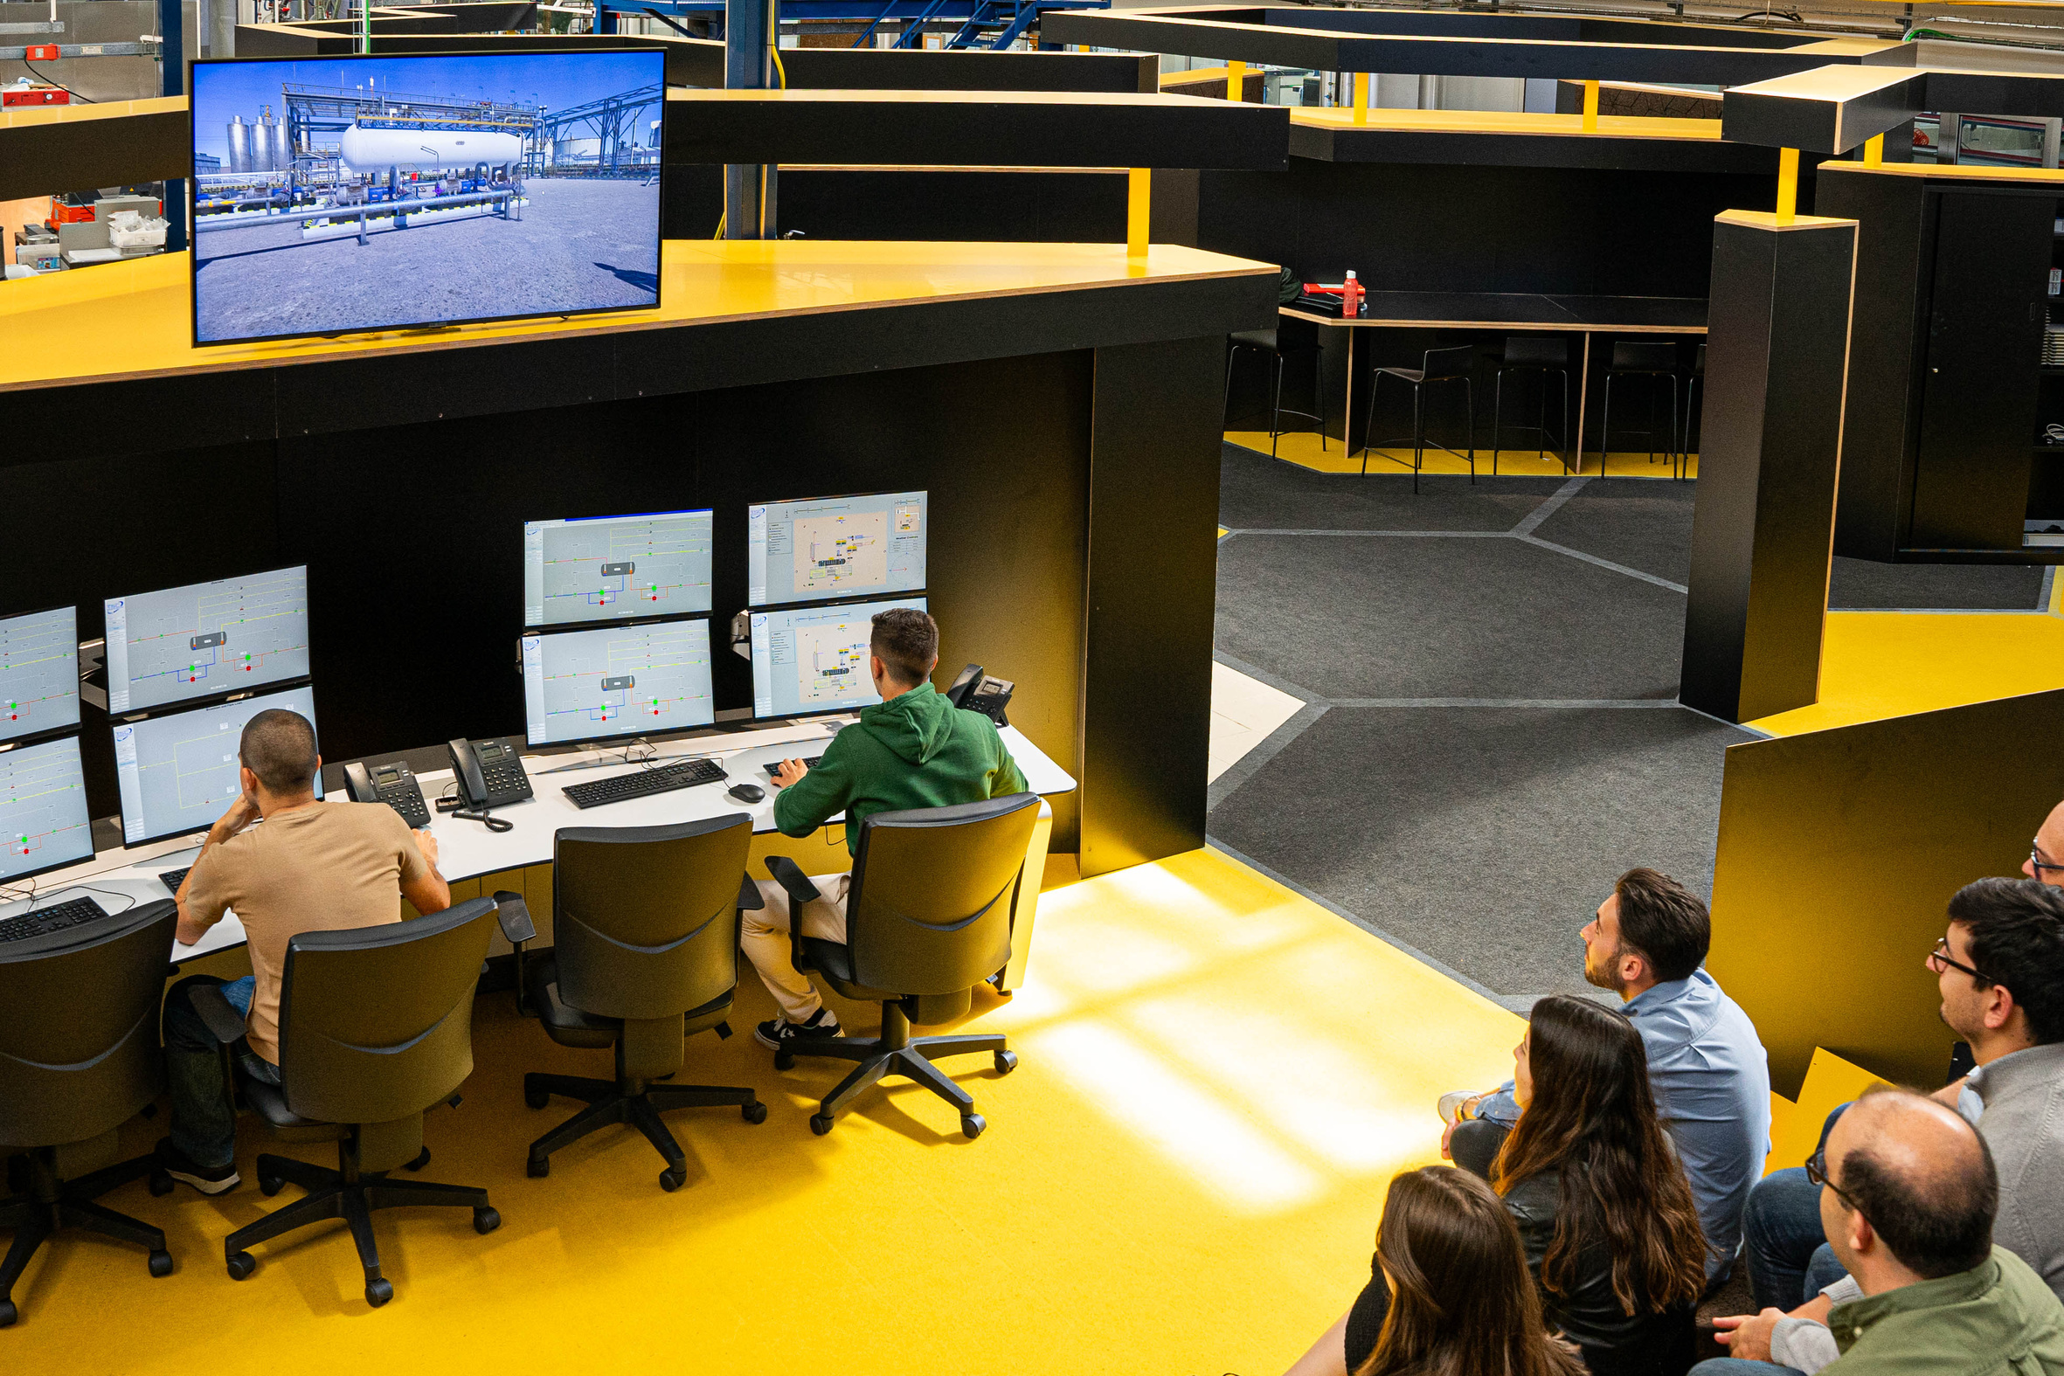

Slide 17
Challenges
Key factors
• Infrastructure
• Sustainable Cities
• Overcame the Car Culture
• Climatic Limitations
• Accessibility
• Technology and Innovation

Slide 18



Creating Science
and Technology
since 1772
Faculdade de
Ciências e Tecnologia

