Slide 1







International Conference
on the Two-Wheels
Sector in Europe:
Present and Future
Organization:
Partners:
More info: https://recuperarportugal.gov.pt/

Slide 2

1. Key Insights from R&D Data in AM2R
2. Technical Scientific Committee
3. Thematic Areas of R&D
4. Disseminations metrics
Index

Slide 3
The Role of the Scientific and Technological System in Innovation - AM2R Successful Case
Ana Reis

Slide 4
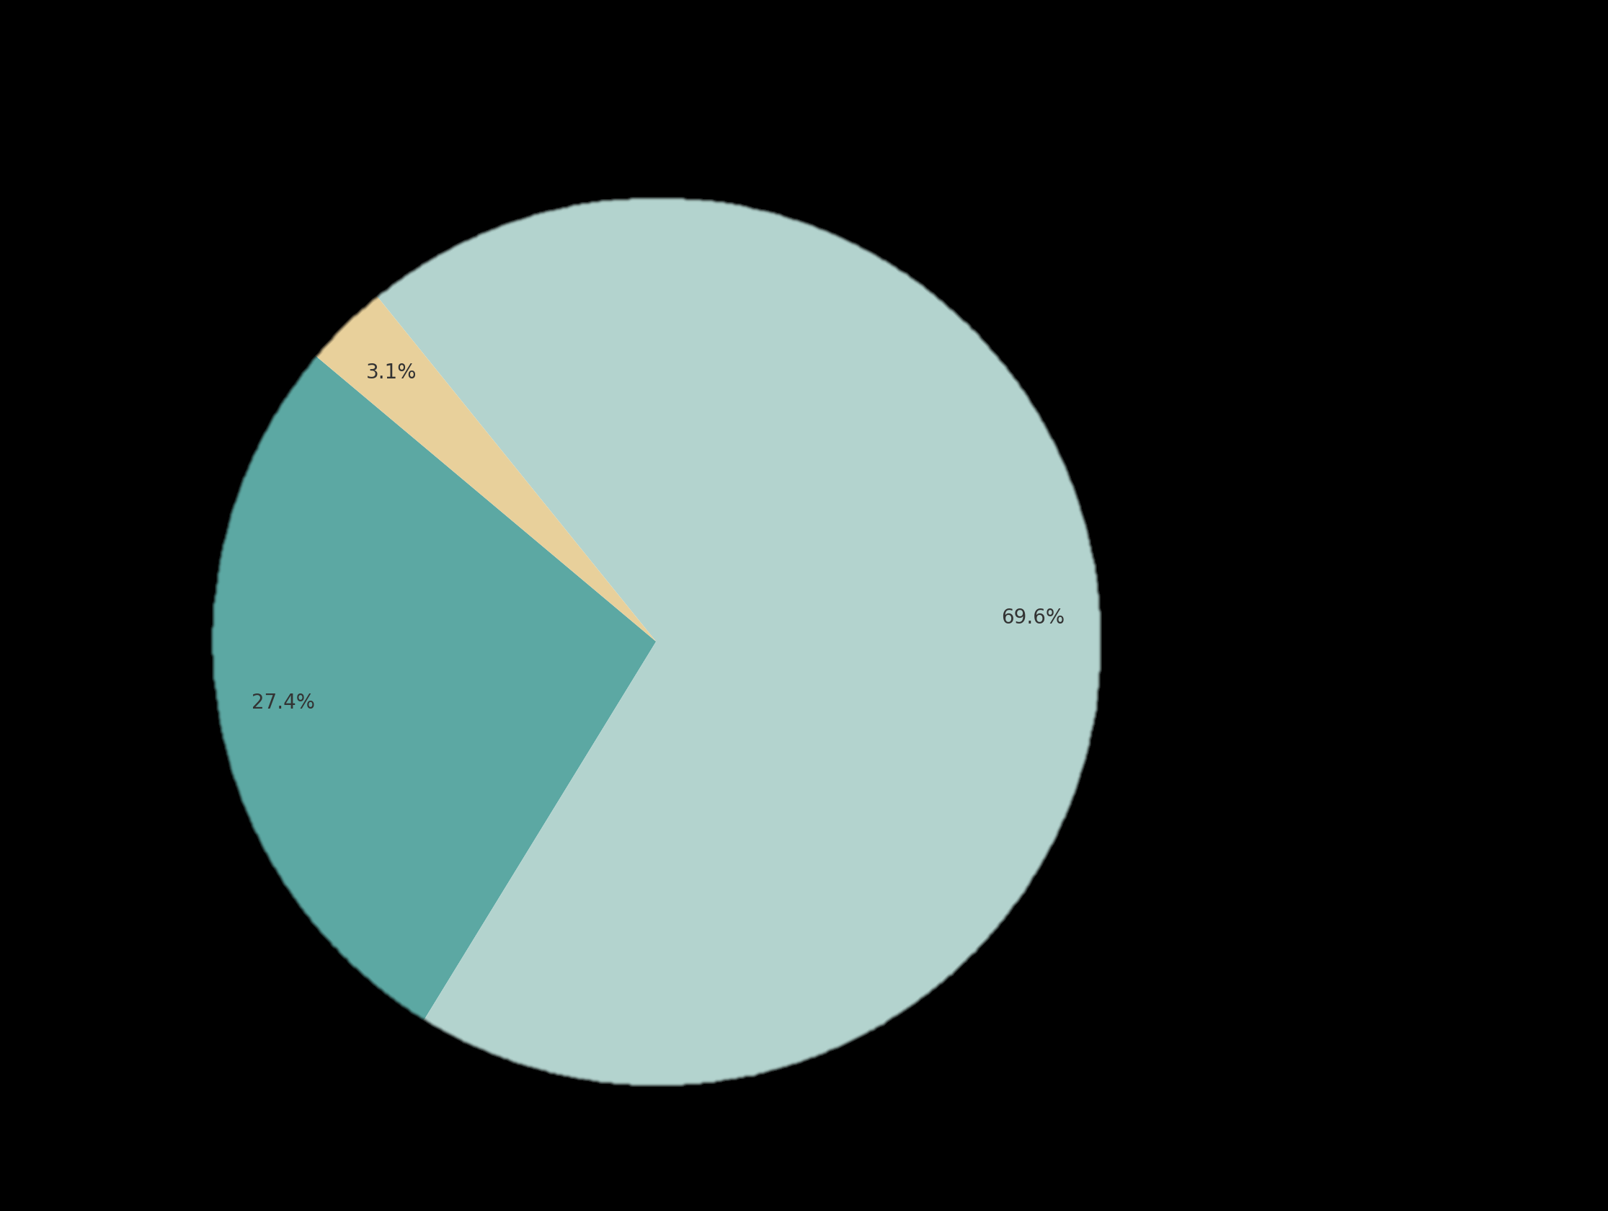
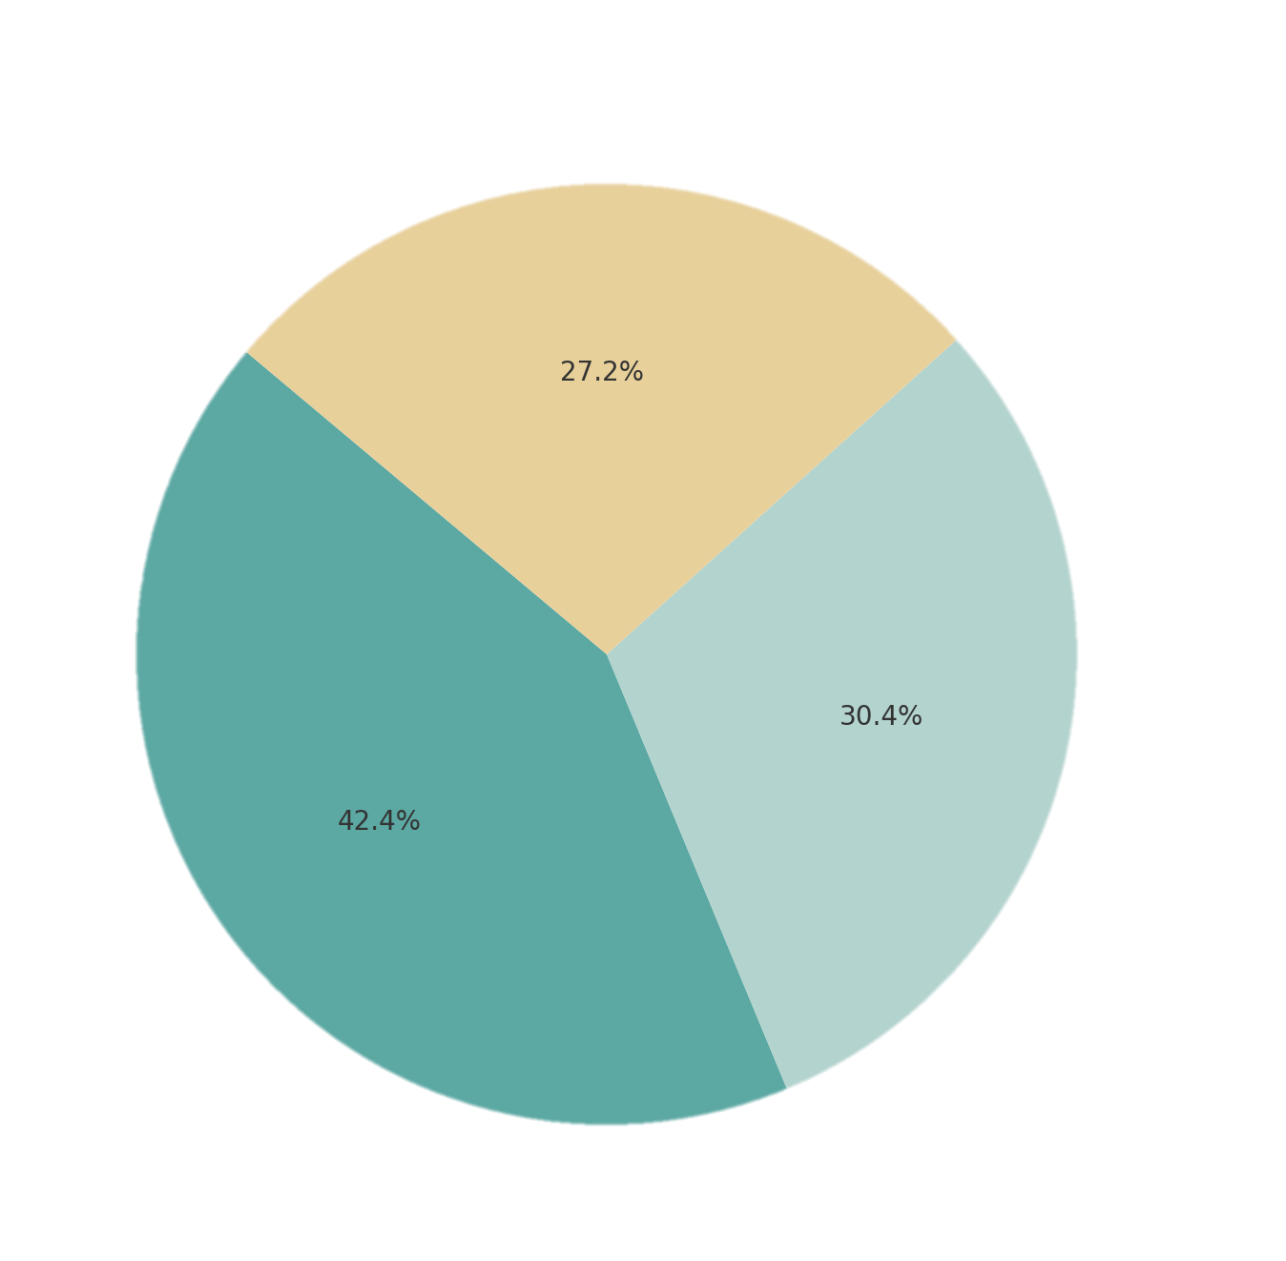
1. Key Insights from R&D Data in AM2R
AM2R Total Investment ~ 210M€
AM2R R&D Investment ~ 40M€
ENESII
IMAGE
R&D
DESCRIPTION
Industry
BIKINNOV
Productive Investment
Notes:
Key Insights from R&D Data in AM2R
R&D accounts for almost 30% of the total investment.
This share represents almost 50 million euros (€).
A significant portion, approximately 40%, was dedicated to the creation of BIKINNOV.
When considering R&D, the industry’s contribution was higher than that of the ENESII partners.

Slide 5
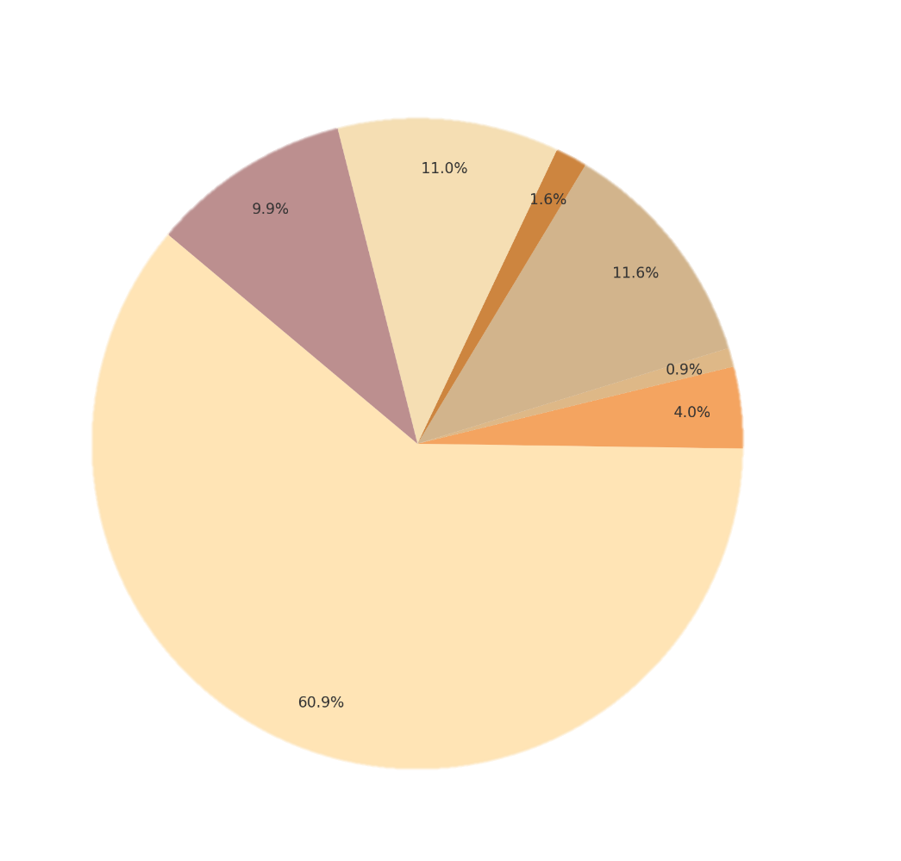







2. Technical Scientific Committee
UA
UC
IPCA
INEGI
CITEVE
CENTI
BIKINNOV

Slide 6
3. Thematic Areas of R&D in the AM2R Agenda
  Product Development
  Innovation in Metals and Surface Treatment
  Future Textiles and Plastics
  Sustainability
  Digitalization and Logistics Challenges

Slide 7
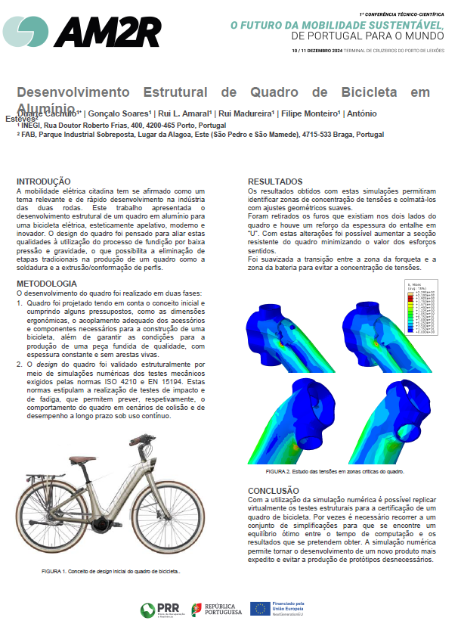
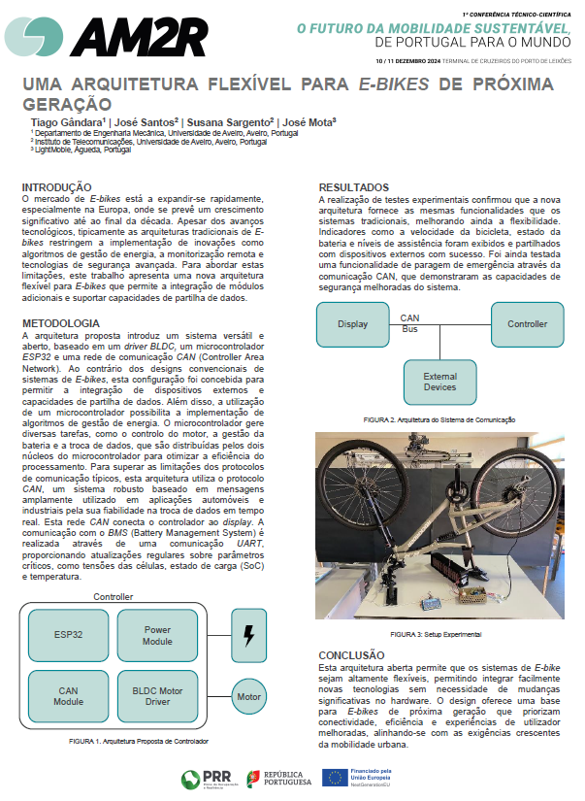
Product Development

Slide 8
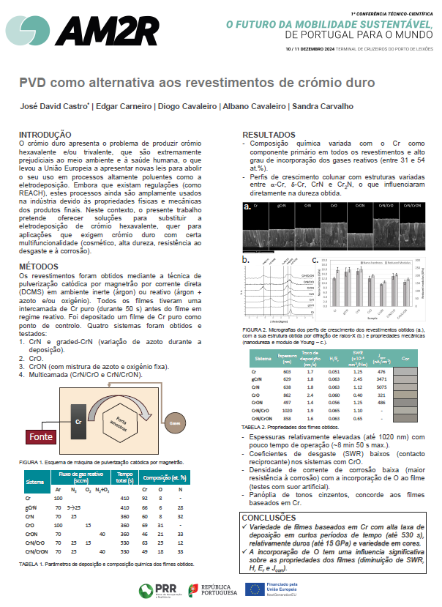
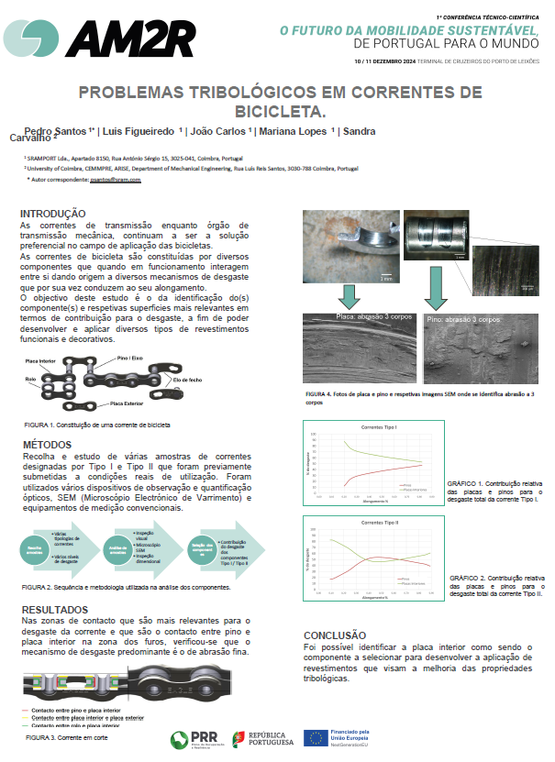
2. Innovation in Metals and Surface Treatment

Slide 9
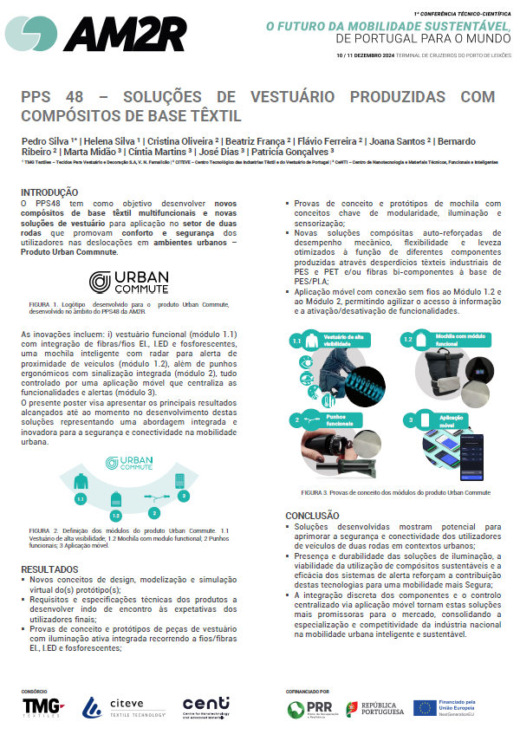
3. Future Textiles and Plastics

Slide 10
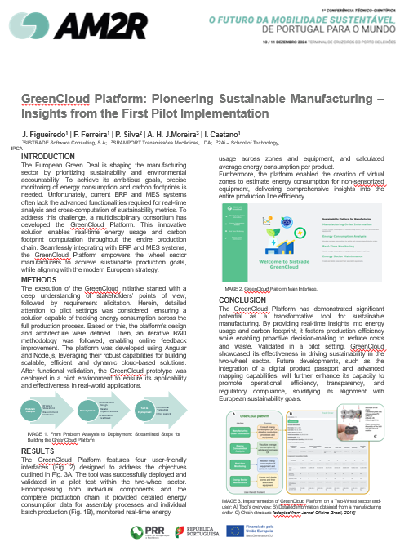
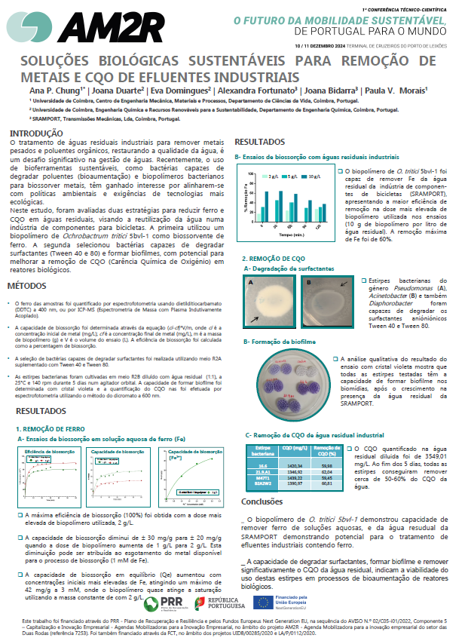
4. Sustainability

Slide 11
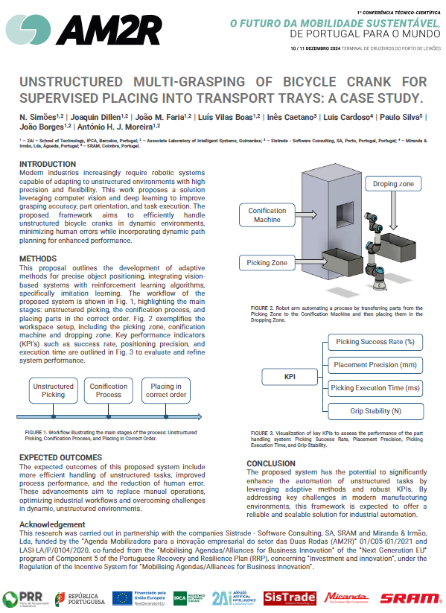
5. Digitalization and Logistics Challenges

Slide 12
4. Disseminations metrics

Slide 13


Slide 14
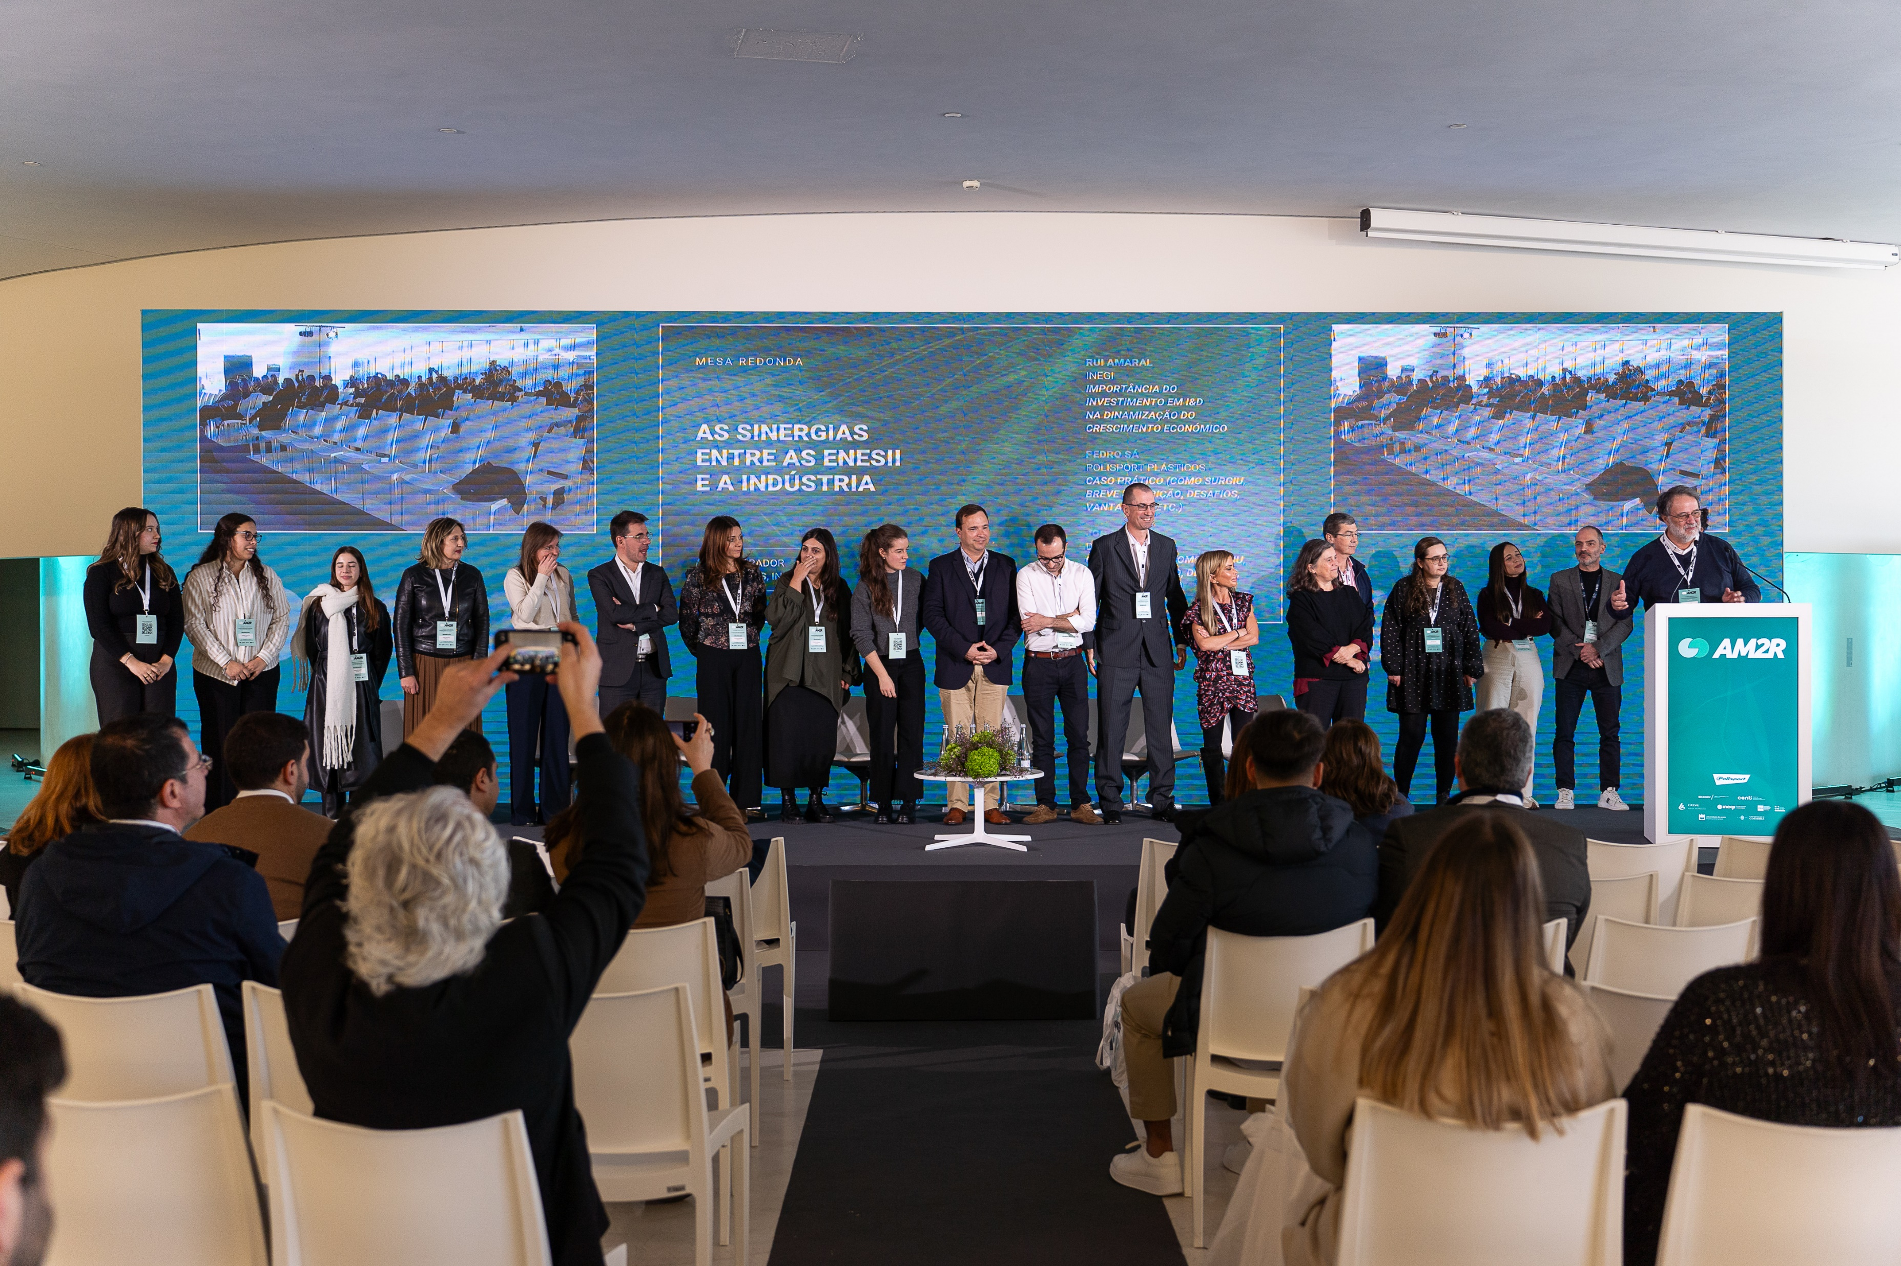
IMAGE
TEXT

Slide 15
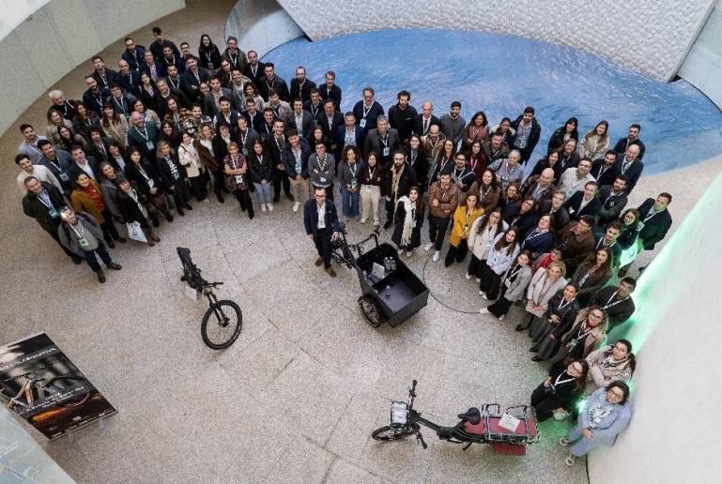
IMAGE

Slide 16
THANK YOU!
Ana Reis
FEUP
Organization:
Partners:
More info: https://recuperarportugal.gov.pt/

