Slide 1
International Conference
on the Two-Wheels
Sector in Europe:
Present and Future
Organization:
Partners:
More info: https://recuperarportugal.gov.pt/

Slide 2
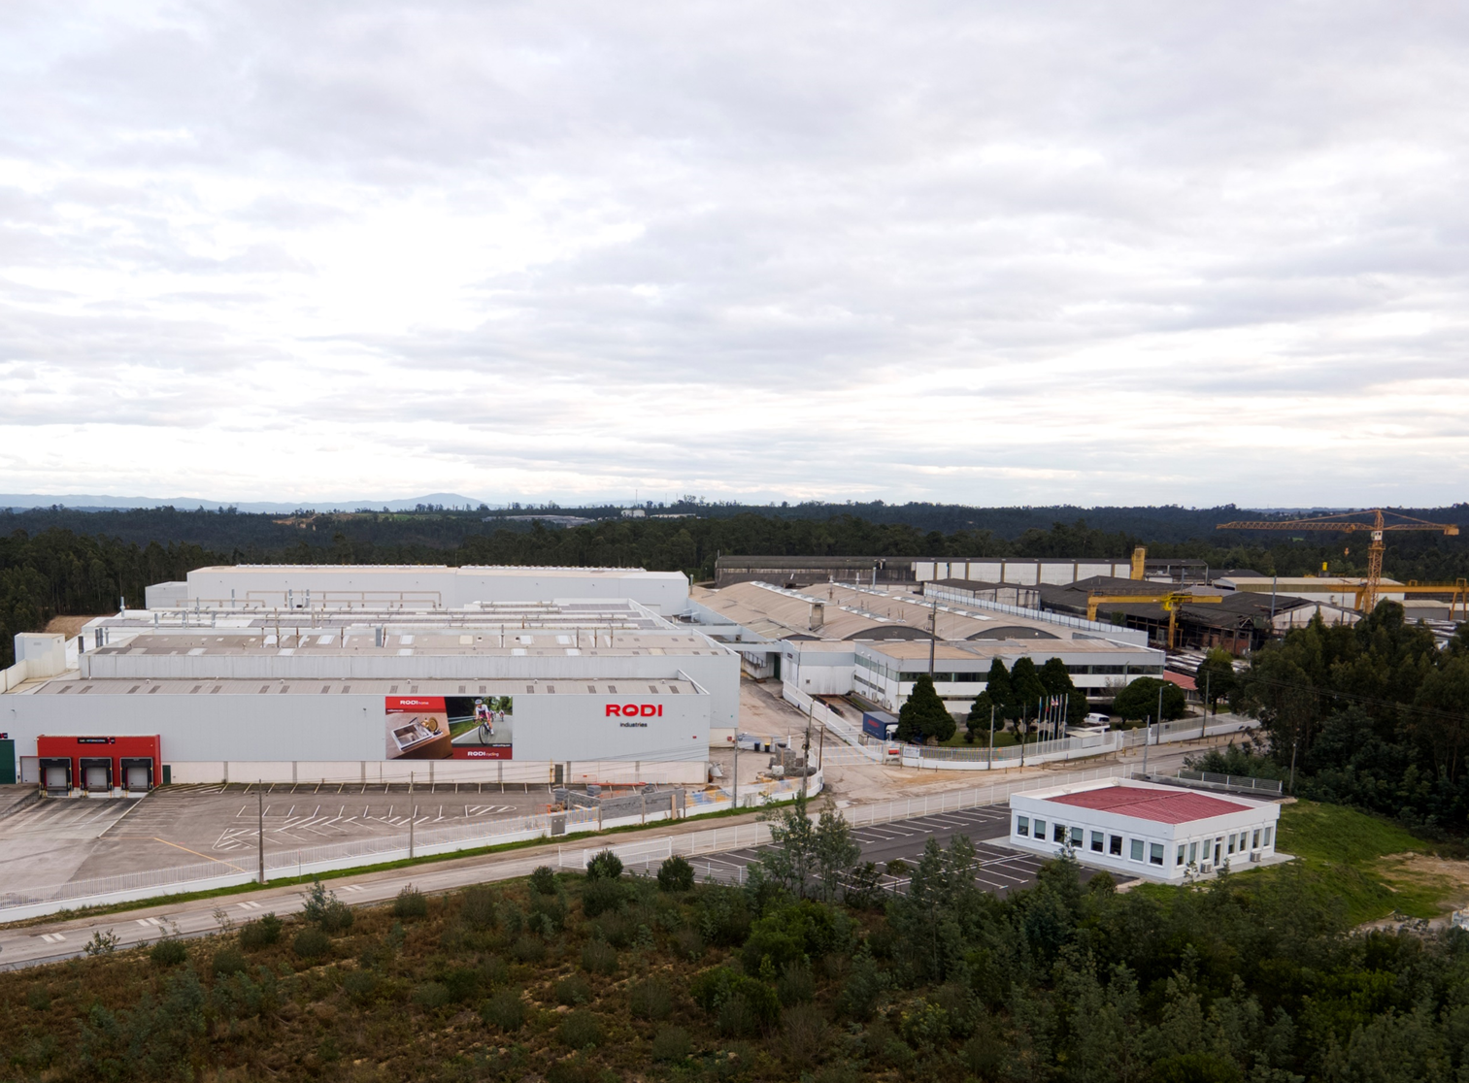
Rodi, a world
of possibilities
Founded in 1952, RODI is a Portuguese company of international renown, standing out in the production of cycling components and the manufacturing of products for the construction sector, such as kitchen and bathroom goods.
IMAGE

Slide 3
Rodi Industries group

Slide 4
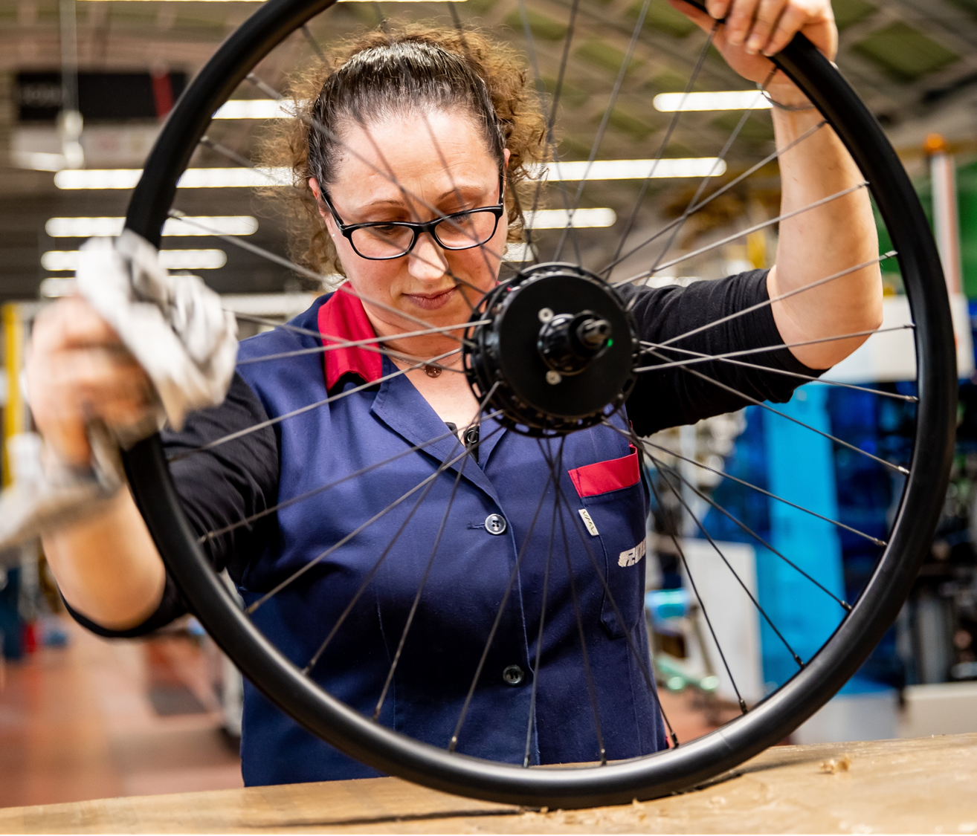
Our cycling numbers
72 years of history
2 cycling brands
86.524 total area (sqm)
3M rims/ year production capacity
400k wheels/ year production capacity

Slide 5
How we do it
Production capacity of 15.000 rims per day
Production capacity of
2.800 wheels per day
11 rim forming lines

Slide 6
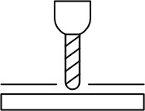
How we do it
15 drilling machines
In-house design and production of components
Production of in-house designs and customization capacity

Slide 7
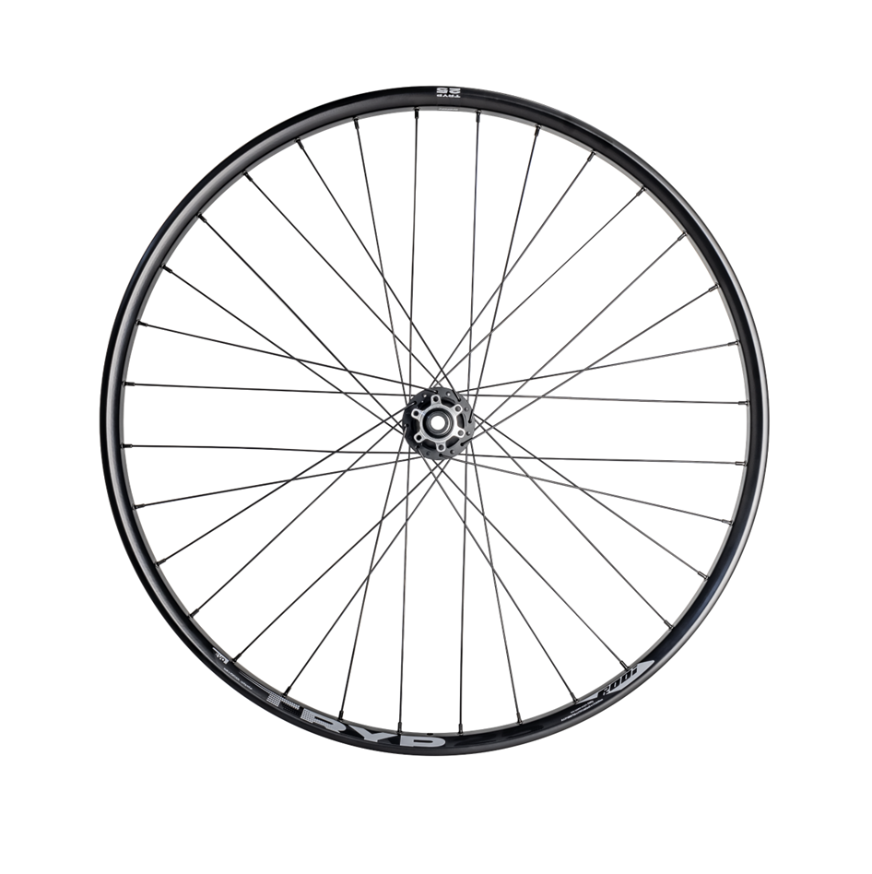
Main challenges
Dependence on external supply chains
The sector has experienced disruptions in global logistics, with delays and rising costs (especially since the pandemic).
Limited control over critical components
Especially hubs, which previously hindered innovation and created third-party dependencies.
IMAGE

Slide 8
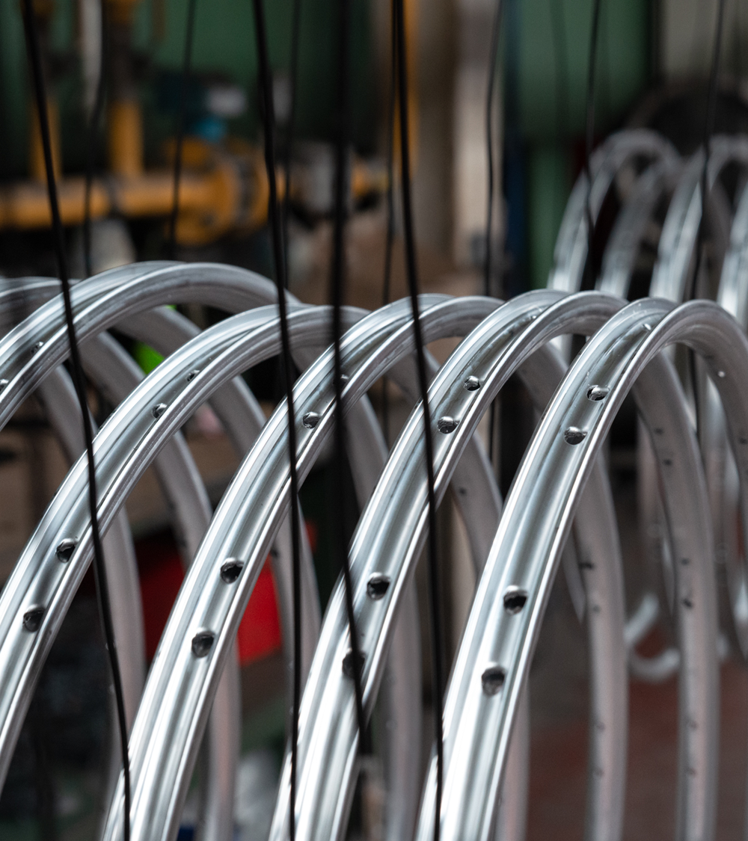
Main challenges
Growing demand for durability and sustainability
Cyclists and OEMs are increasingly seeking products that are not only high-performing but also durable, serviceable, and environmentally responsible.
Market slowdown and stock saturation
Many retailers are holding excess inventory, delaying new orders and slowing market entry for new products.
IMAGE

Slide 9
Our strategy
Investment in innovation and in-house engineering
Development of a proprietary ratchet hub system, focused on performance, durability, and easy service.
Collaboration with partners like Hydro to develop custom aluminium alloys with enhanced mechanical properties.
European and sustainable manufacturing
All production is based in Portugal, reducing emissions and improving supply chain resilience.
Internalised surface treatments (e.g. anodising), oil recovery systems, water-saving technologies, and recycled aluminium are part of the sustainability roadmap.

Slide 10
Our strategy
Focus on durability, serviceability, and modular design
Products are designed to last, with easily replaceable and repairable components. This supports a circular economy model and reduces product obsolescence.
Strong OEM partnerships and technical retail channels
Collaborations with boutique bike brands, OEMs, and specialist wheel builders who value engineering quality and serviceability.

Slide 11
THANK YOU!
Armando Levy
levy@rodi.pt
Organization:
Partners:
More info: https://recuperarportugal.gov.pt/

