Slide 1



Ride the Future
www.bikinnov.pt

Slide 2


About BIKiNNOV
BIKiNNOV, the Bike Value Innovation Center Association, is a private non-profit association created on 8 March 2022. Located in Águeda, Portugal, it operates as a Technology and Innovation Centre dedicated to supporting companies in the two-wheel sector.

Slide 3



About BIKiNNOV
Vision
Providing technical and technological support to companies in the two-wheel sector
Promoting the use of technology and innovation as tools to improve business competitiveness
Increasing added value and qualifying the offer

Slide 4
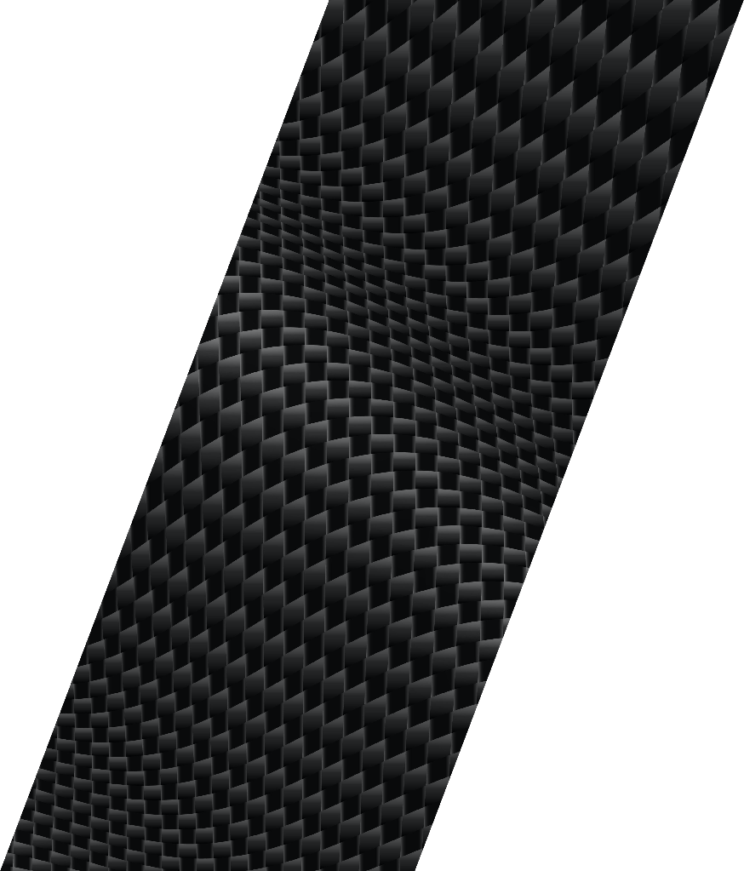

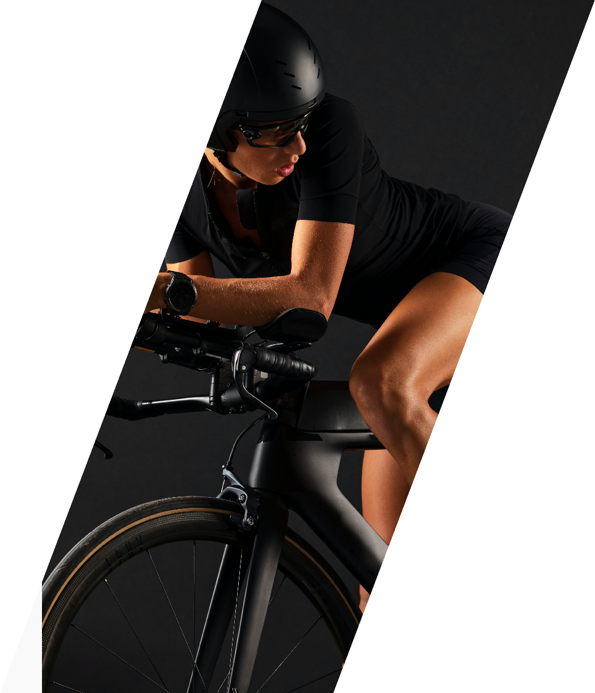
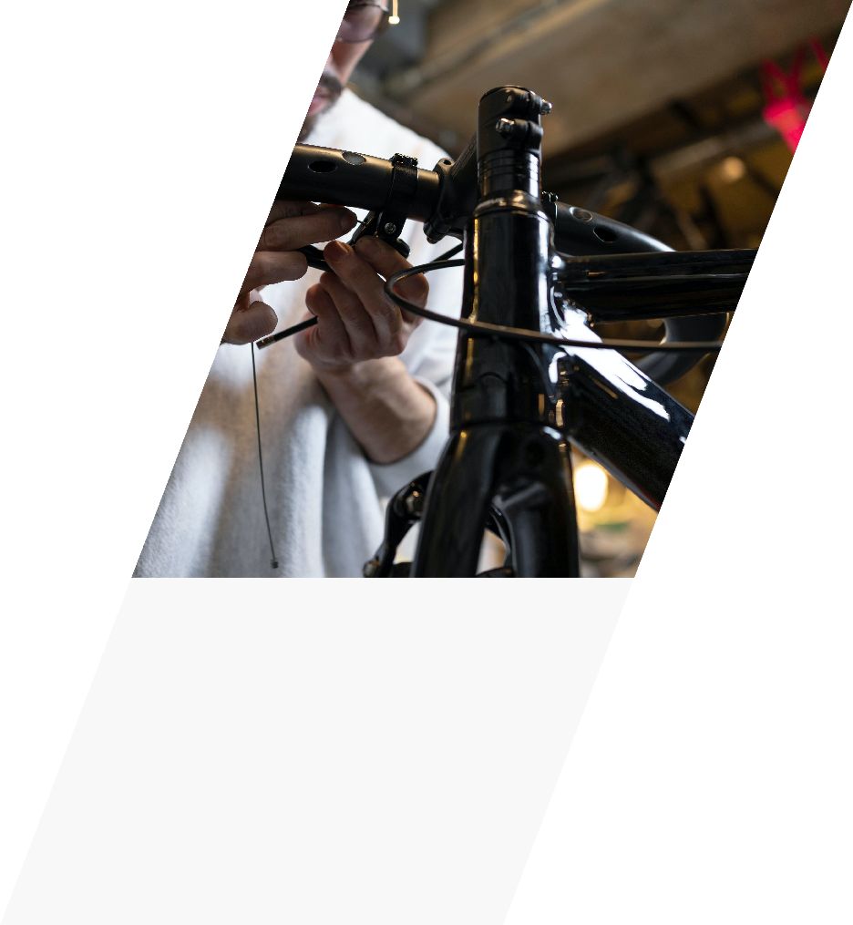
MAIN AREAS OF ACTIVITY
INDUSTRIAL PROCESSES
MATERIALS LABORATORY
PBV Digital Factory with the dual function of Learning Factory and Solutions Development Laboratory
Experimental laboratory for the development of methods for evaluating the performance of materials and products
PRODUCTION TECHNOLOGIES
PRODUCT AND SERVICE DEVELOPMENT
Development of advanced materials with potential application in highly technical fields
Prototyping and development of innovative products in collaboration with SMEs
Notes:
O texto foi fornecido por nós mas temos que rever
Por exemplo para a área dos materiais, o objetivo é muito maior do que só definir métodos

Slide 5

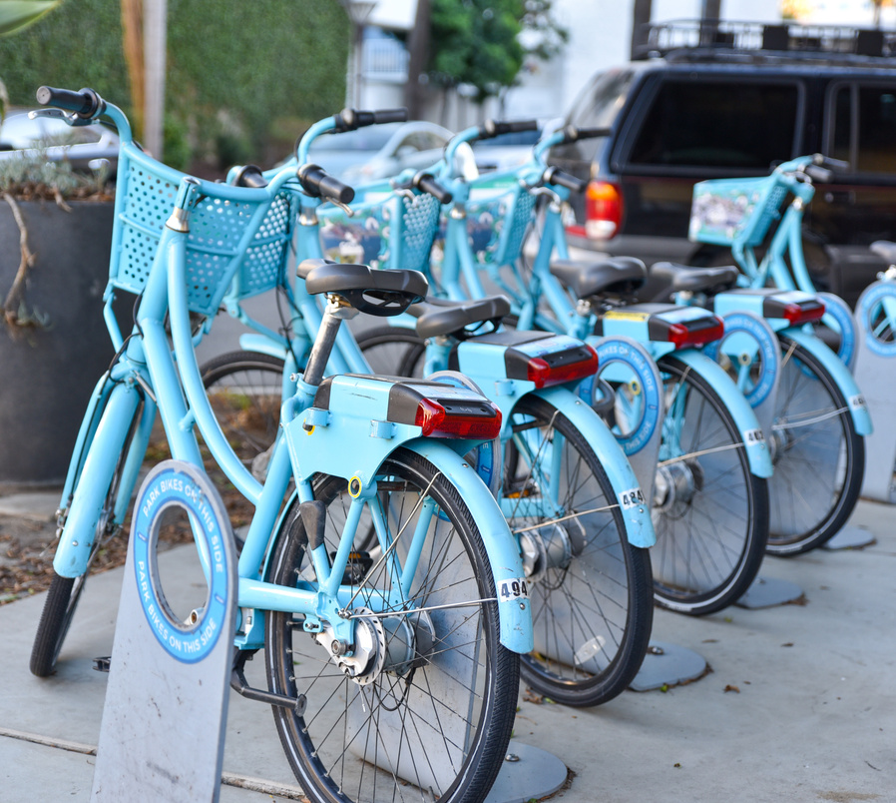



About BIKiNNOV
Guiding principles
Sustainability
Digitalization
People and Intellectual
Property
Networking

Slide 6
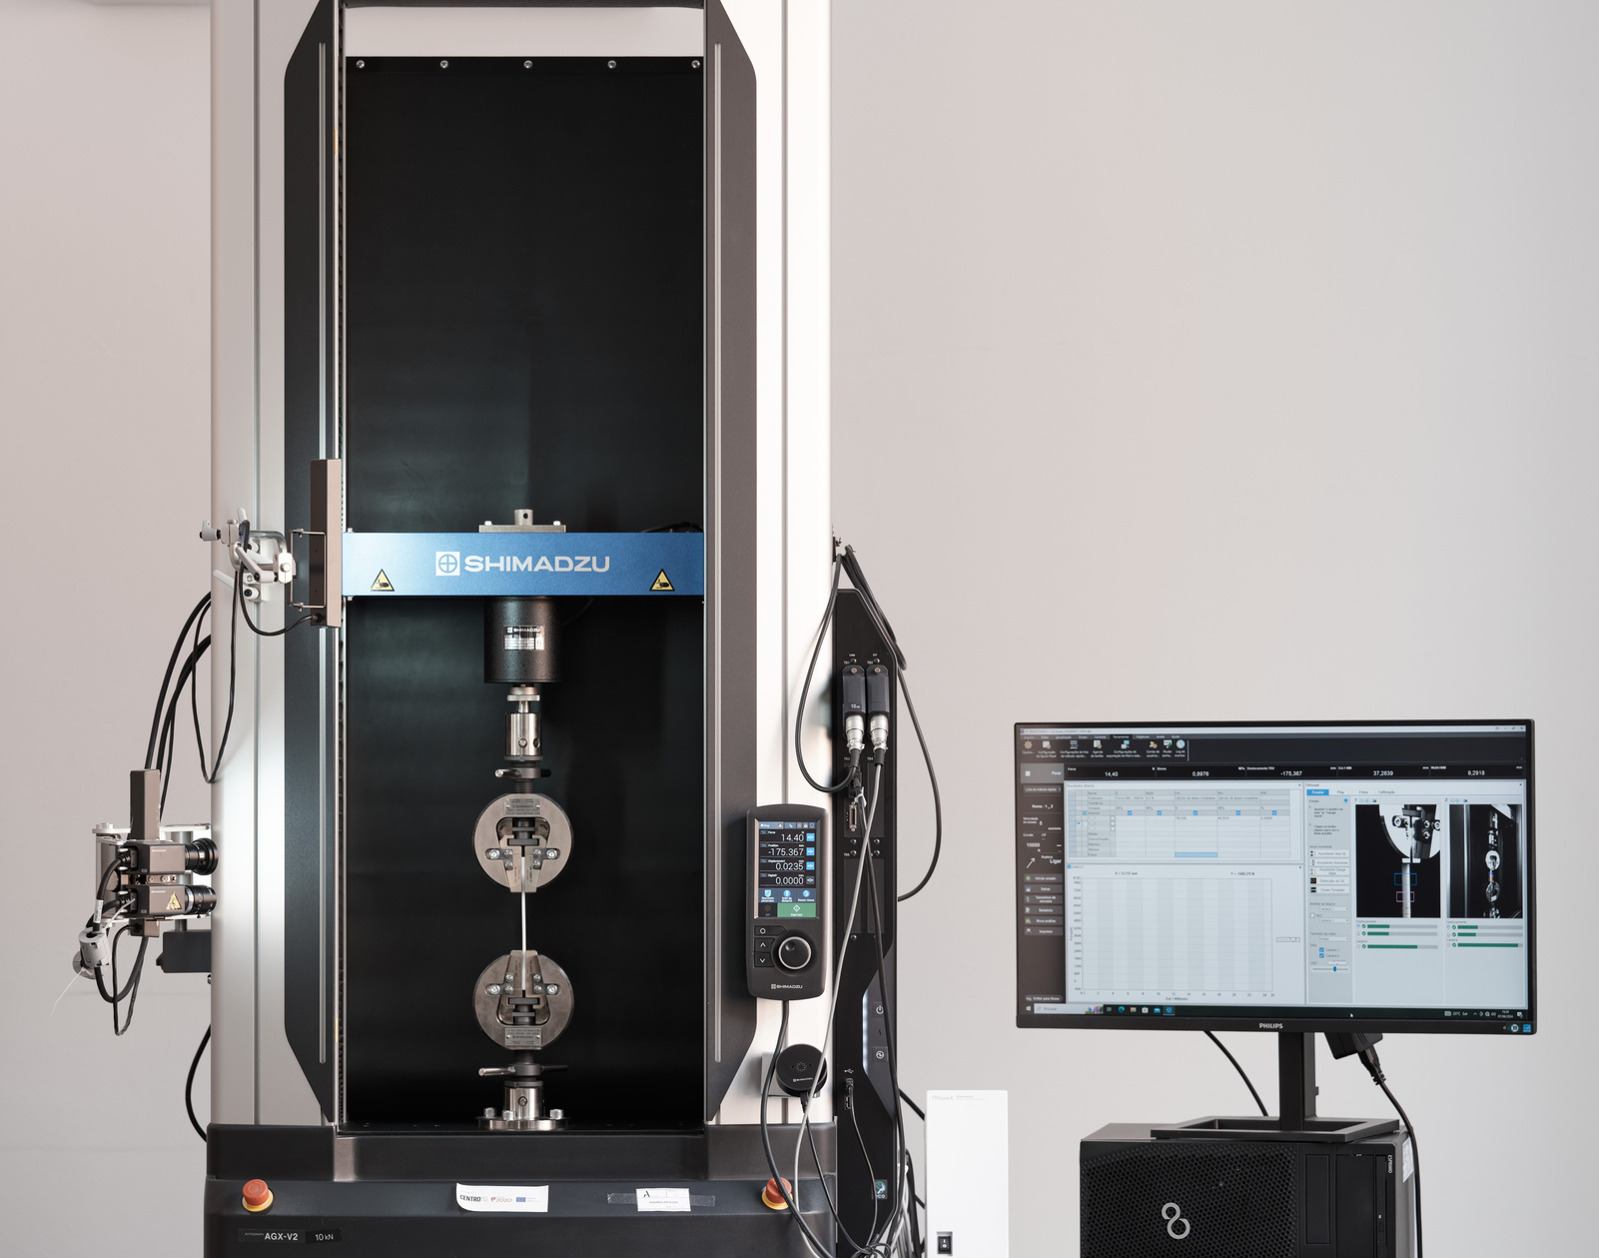
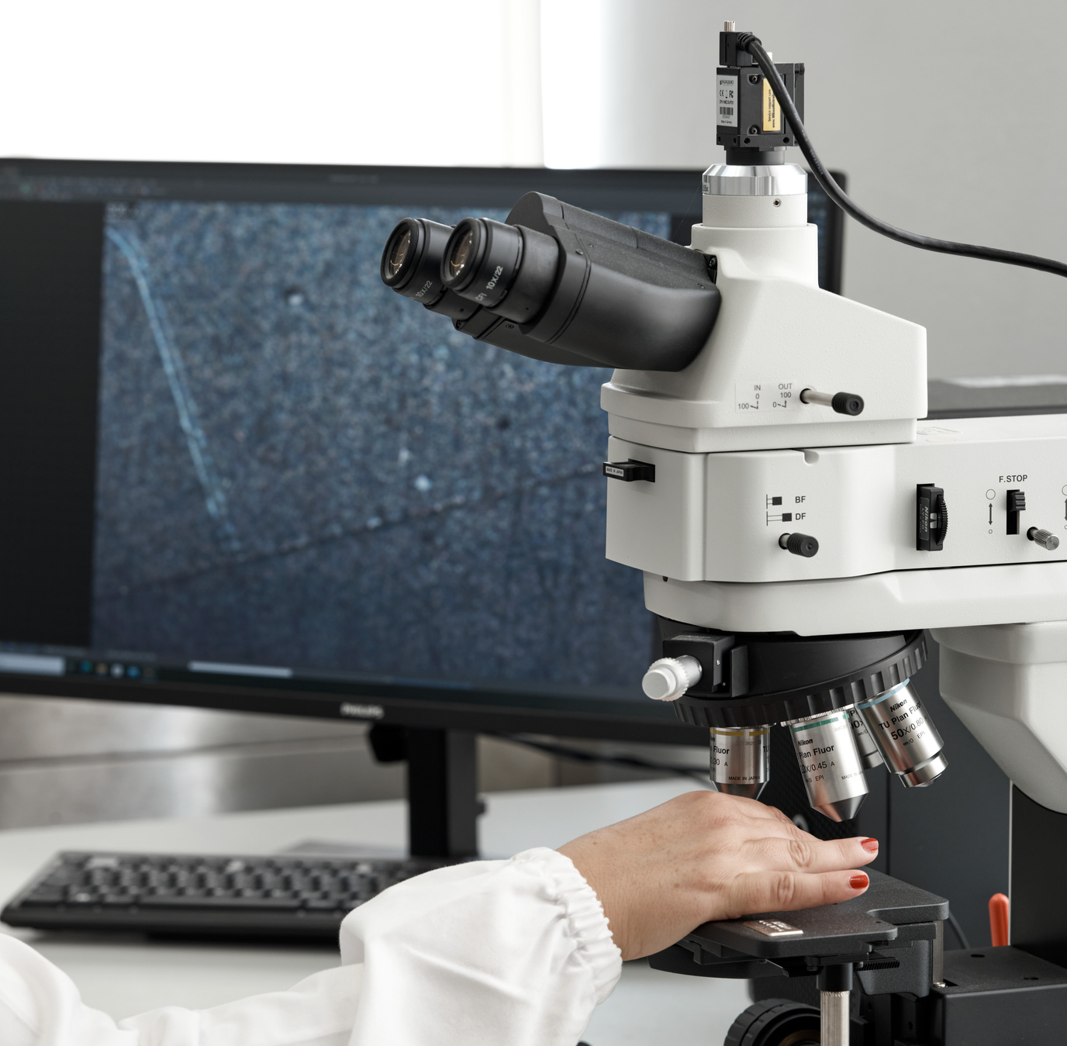
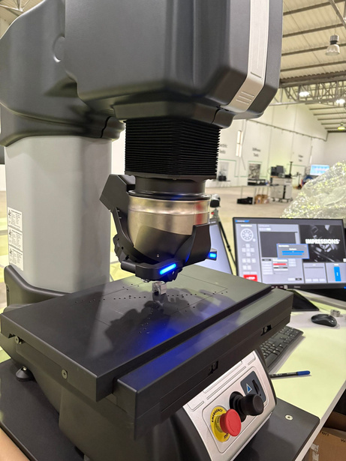
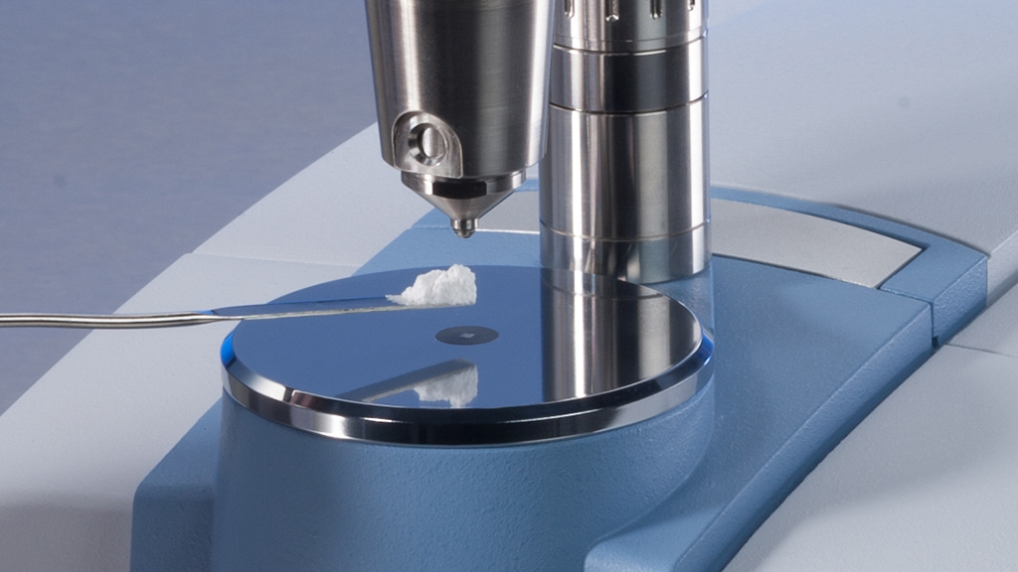

Our Capacities
Characterisation of materials (metals, polymers, composites)
  Mechanical properties
  Hardness
  Microstructure and macrostructure
  Elemental and molecular chemical composition
  Metallographic analysis
  Weld Characterisation
Static and dynamic tests
Macro and microstructural analyses
Hardness tests on various scales
Characterisation of polymers and composites

Slide 7
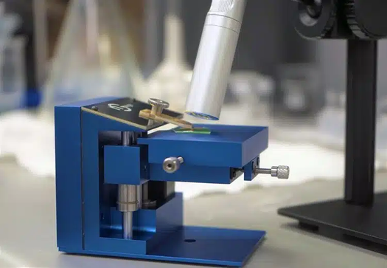
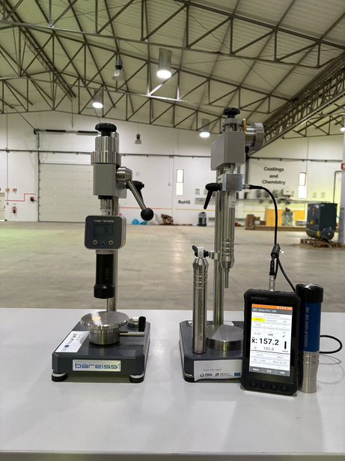
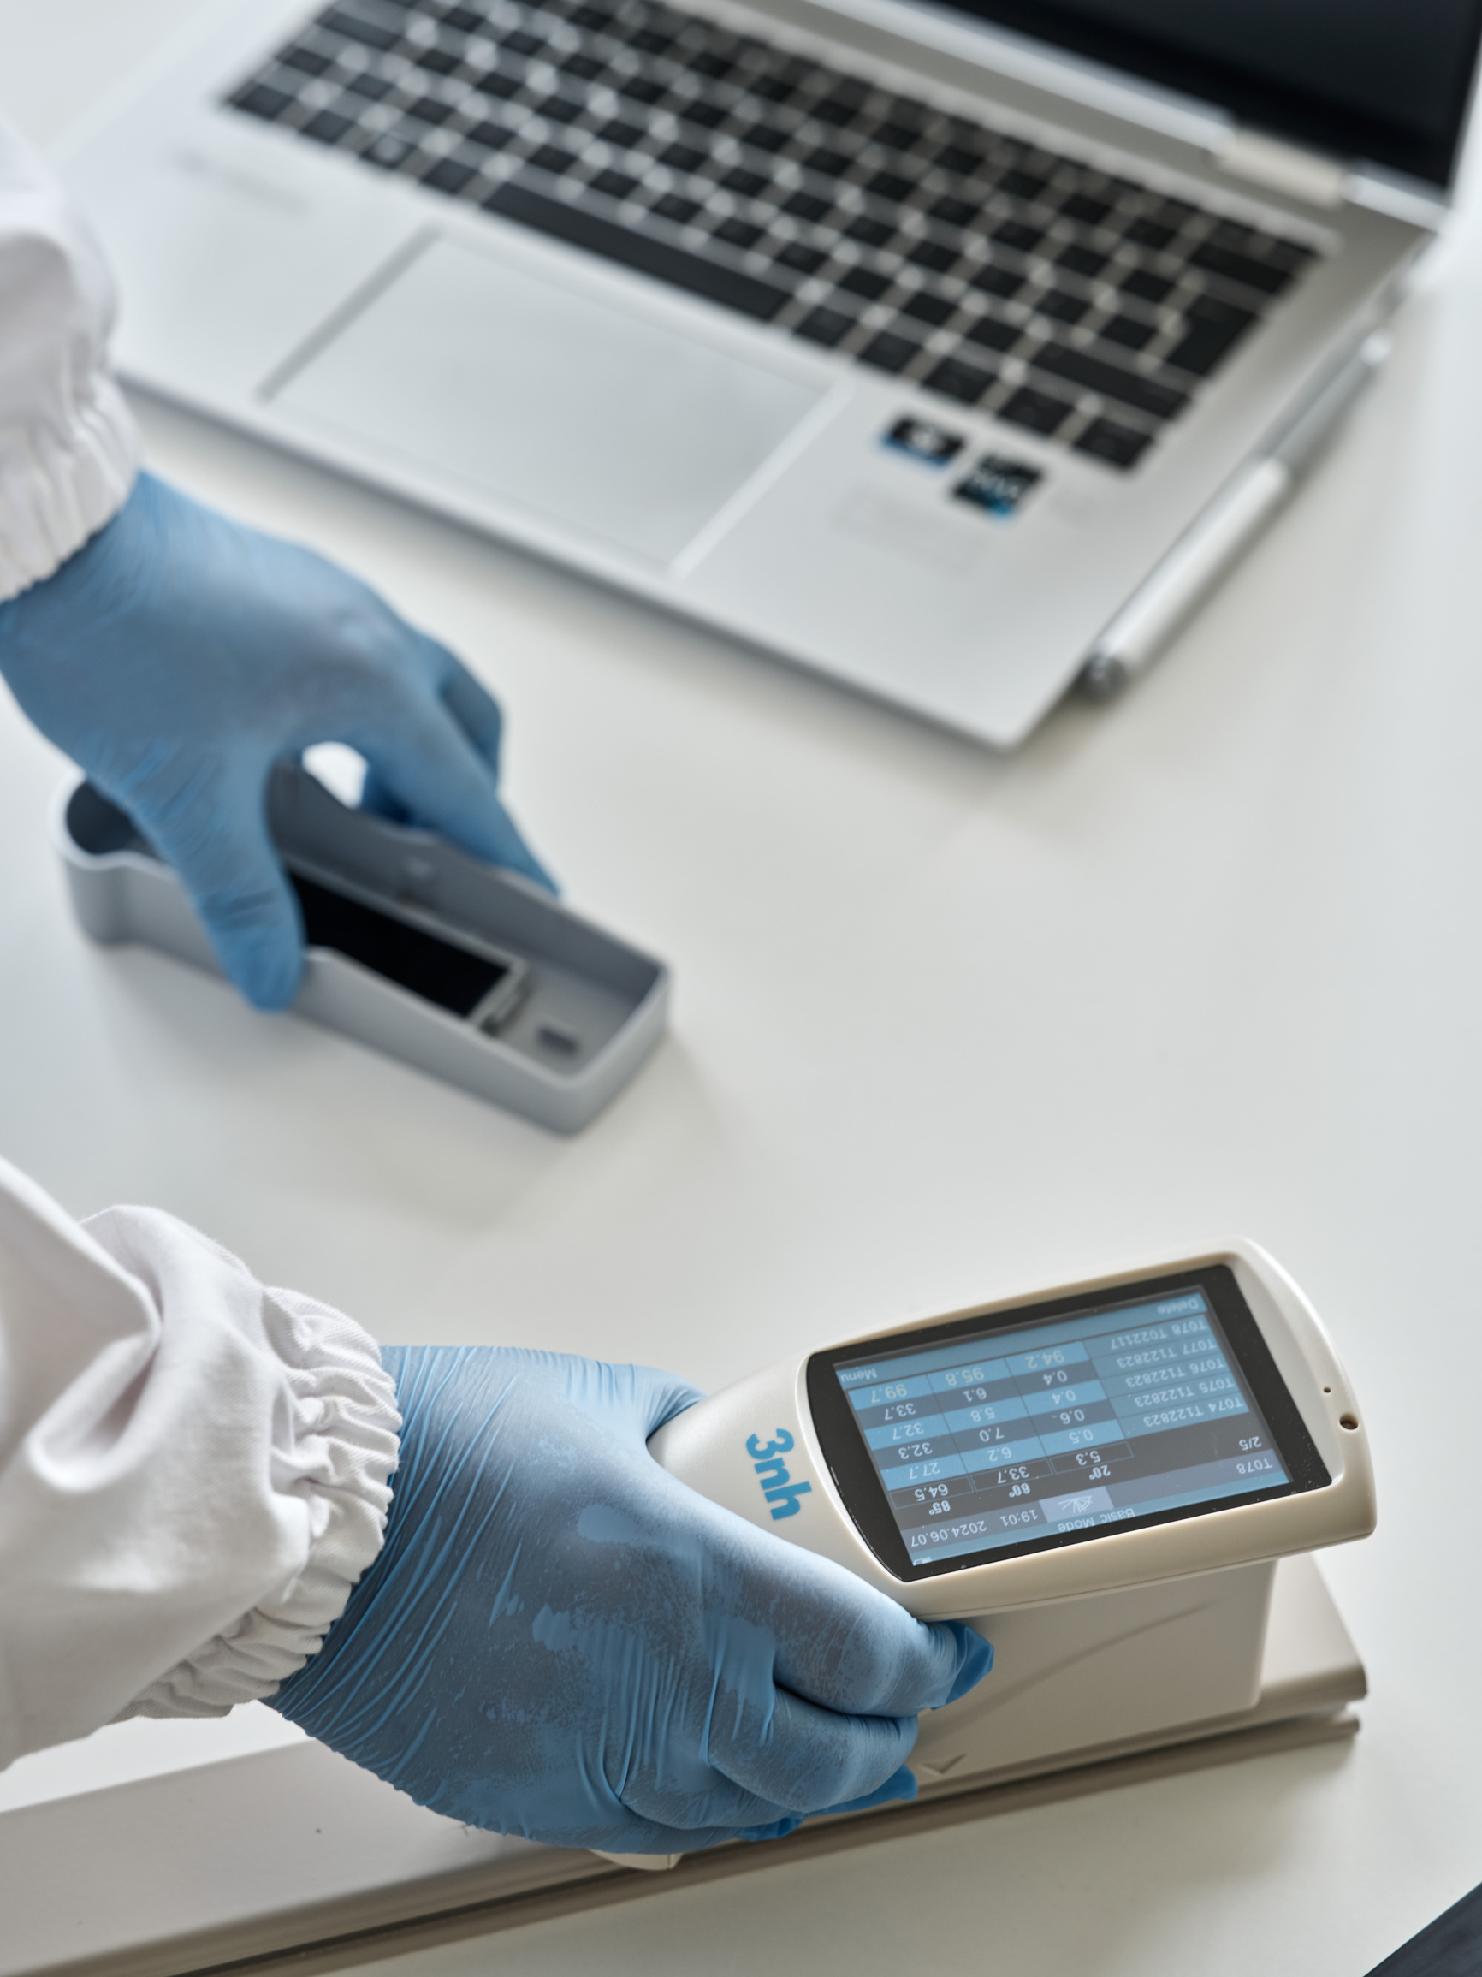
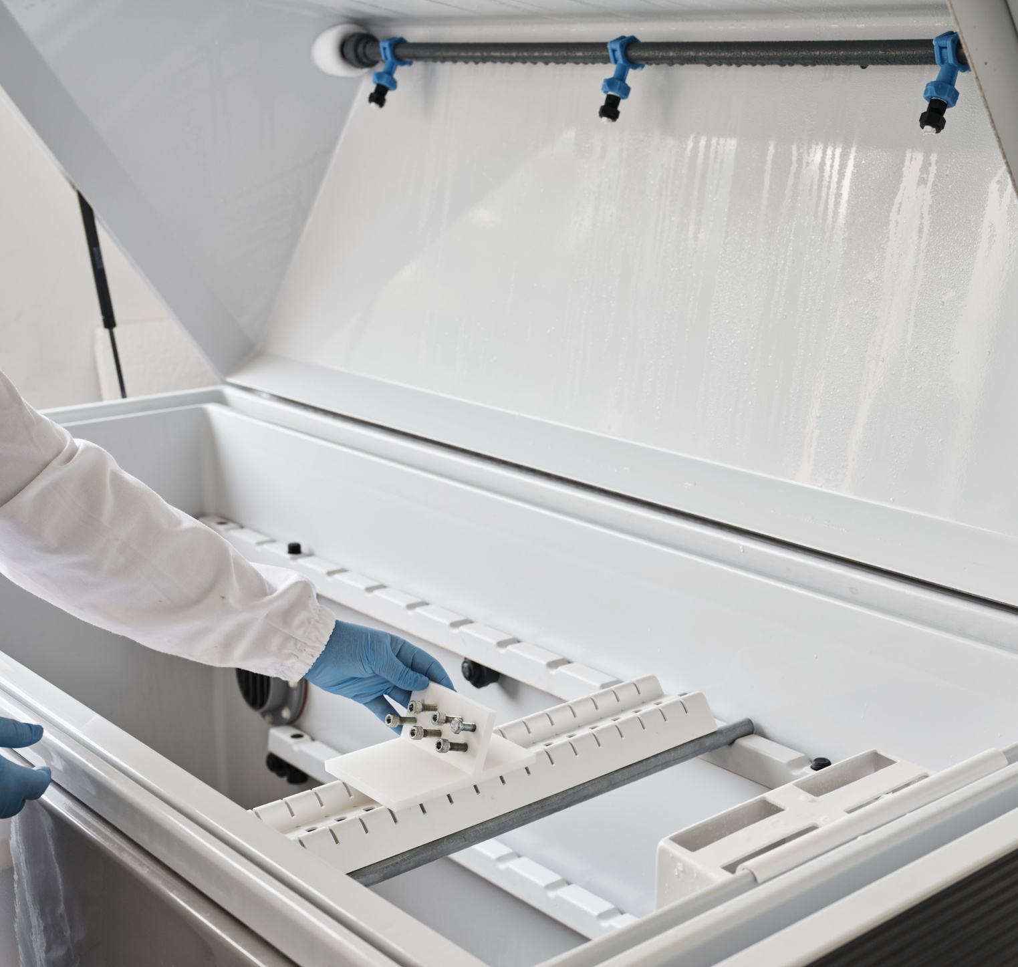
Our Capacities
Characterisation of materials (metals, polymers, composites)
  Topography on the nanometer scale
  Surface hardness
  Coating thickness
  Resistance to exposure to corrosive environments, temperature variations, humidity, rain, UV light
Atomic force microscopy (AFM)
Hardness tests on various scales, with adjusted load
Determination of the properties of paints and coatings
Corrosion resistance tests

Slide 8

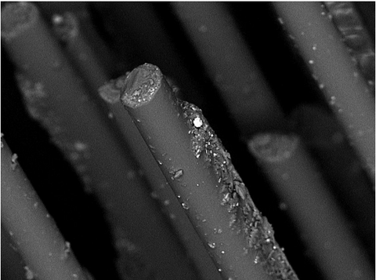
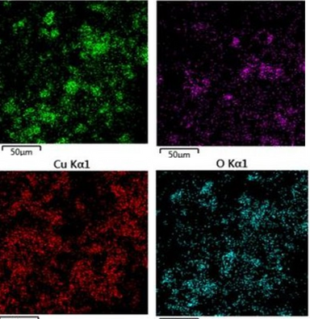
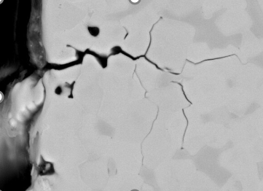
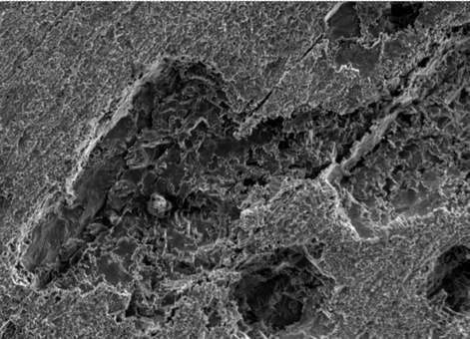
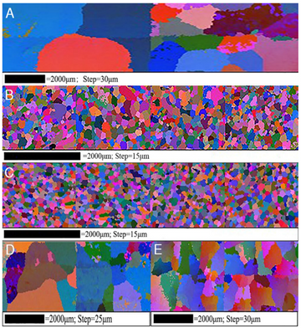
Our Capacities
Scanning Eletron Microscopy - SEM
  High magnification and high spatial resolution - magnification up to 2M times and resolution down to 0.5 nm ( 15 kV)
  High depth of field - Maintains sharp focus even on uneven surfaces
  Composition analysis - Can be combined with other techniques to identify chemical elements in the sample
  Can analyse porosity, identify fractures and study corrosion
Elemental mapping by EDS
Fractures
Corrosion
Contamination
Microstructural analysis by EBSD

Slide 9
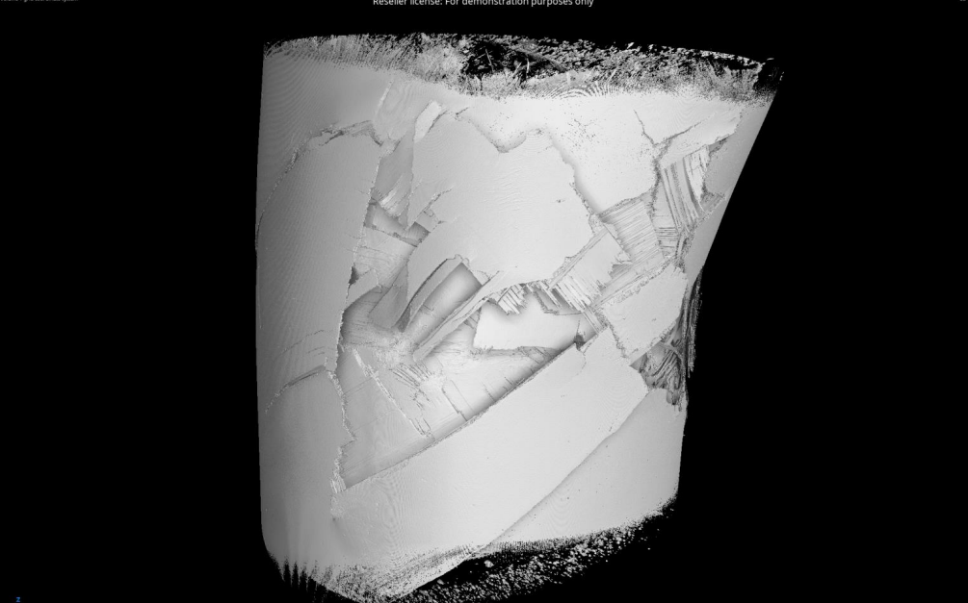

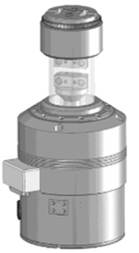
Our Capacities
Tomography
  Maximum analysis volume : 800 mm (Ø) x 1415 mm (H)
  Maximum sample weight: 275 Kg
  2 X-ray sources;
  Resolution: ~0.8 μm;
  Power: 3 W to 450 W;

Slide 10
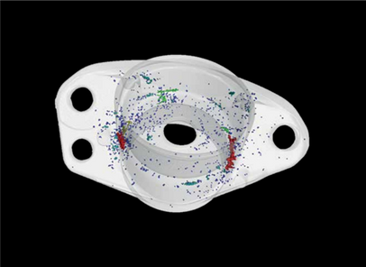
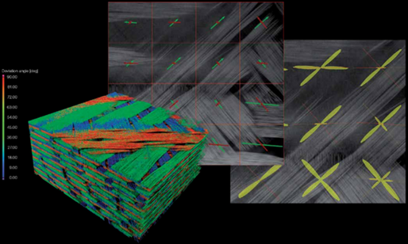
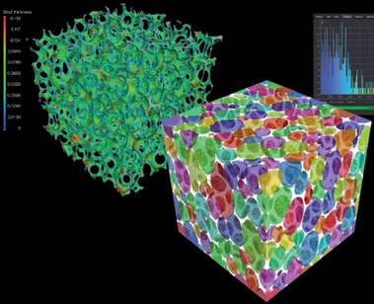
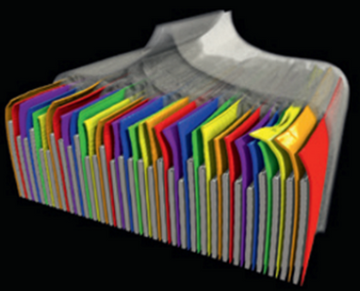
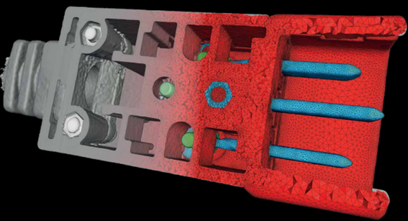
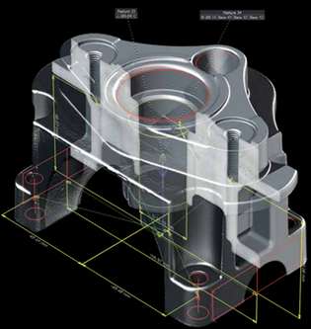
Our Capacities
Tomography
Identification and non-destructive characterisation of:
  Internal Defects
  Porosity
  Inclusions
  Fractures
  Structural integrity
Porosity and crack analysis
Fibre orientation analysis in composites
Analysing powders and porous materials
Battery analysis
Creation of reliable meshes for computer simulations
Dimensional Analysis

Slide 11

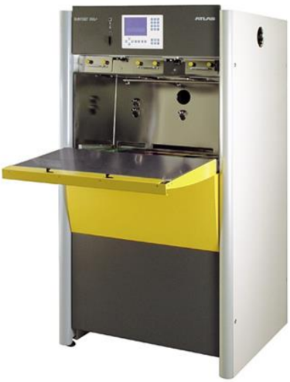
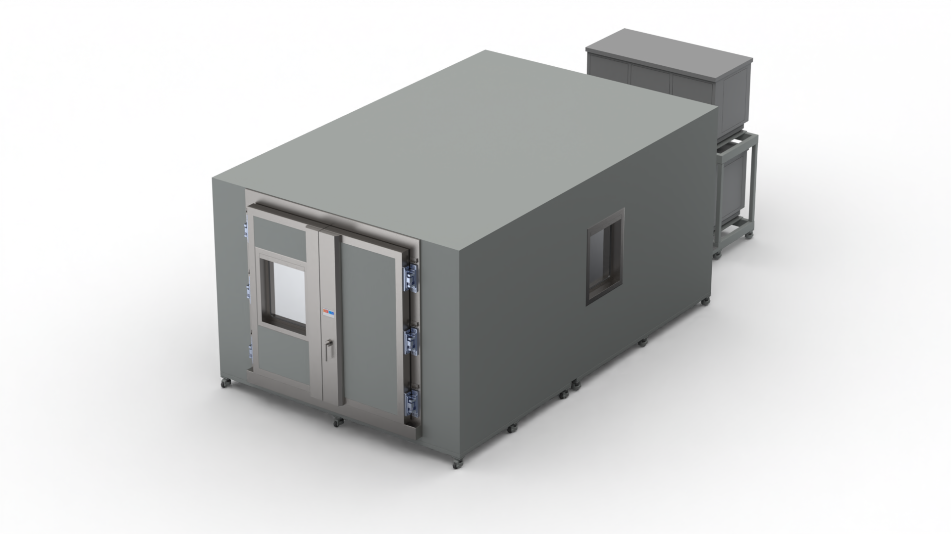
Our Capacities
Exposure to environmental conditions
  Extreme cycles of temperature variation, alternating between conditions of intense cold and high heat.
  Testing and validation of components exposed to ultraviolet radiation, ensuring the long-term performance of both materials and coatings.
  Simulation of environmental conditions including rain, snow and global radiation tests and protection certifications such as IPX4 and IPX5;
Thermal and UV Shock Chamber
Walk In

Slide 12
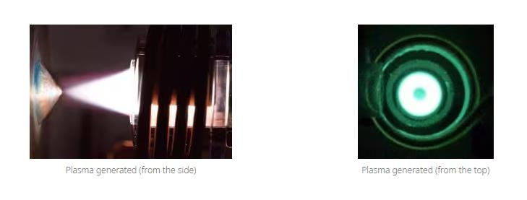
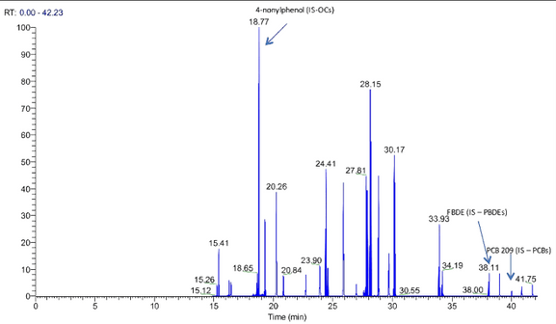
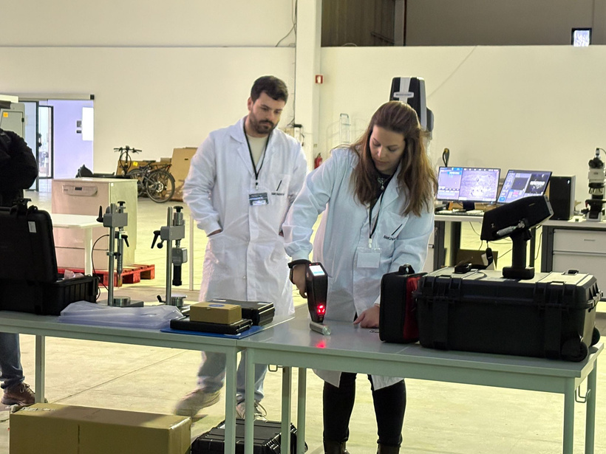
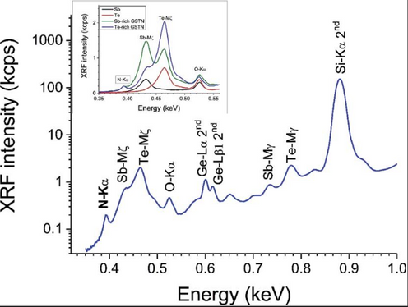
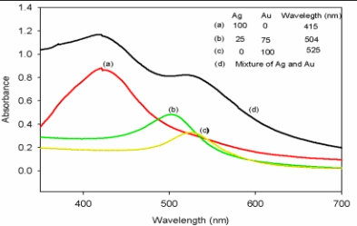
Our Capacities
Chemistry and the Environment
Considering the specificities of the REACH Regulation and the RoHS Directive, BIKiNNOV's role will be to support its partners by analysing the restrictions to be considered under REACH on a case-by-case basis and conducting laboratory analyses to verify the product's compliance with the legislation in force.
We have a laboratory trained for this purpose.
Determination of heavy metal content:
ICP-MS
Determination of phthalate (REACH restriction no. 51) and PAH (REACH restriction no. 50) content:
GC-MS
Portable non-destructive sample evaluation with RoHS :
XRF + libs
High sensitivity analysis by
WDXRF
UV visible

Slide 13
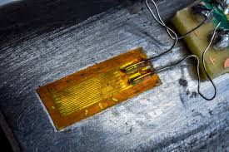
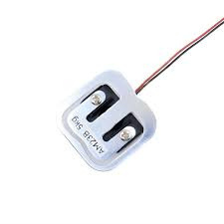
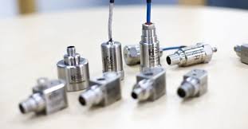
Our Capacities
Sensorisation
Instrumenting products with sensors allows precise data to be collected during tests and trials. This approach is essential for validating simulation models, improving safety and optimising the performance of components and structures.
Strain Gauges
Load Cells
Accelerometers

Slide 14
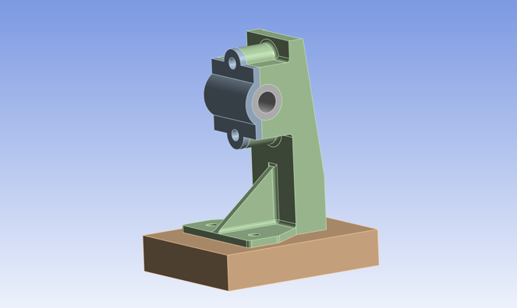
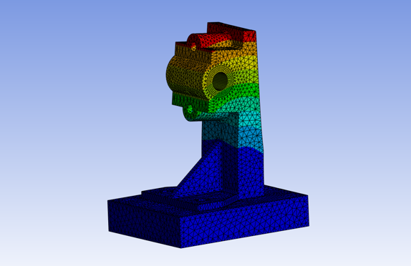
Our Capacities
Modelling and Simulation
Modelling and finite element simulation are essential tools in engineering and science for predicting the behaviour of complex physical systems. This approach makes it possible to analyse structures, fluids, heat transfer and other physical phenomena accurately and efficiently.
Modelling a support
Simulating a support

Slide 15
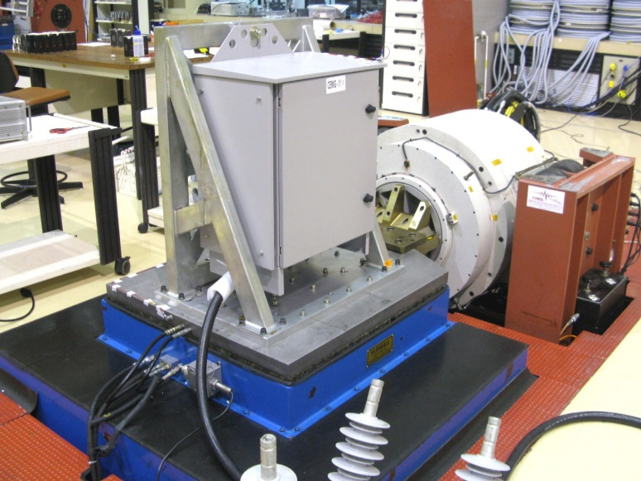
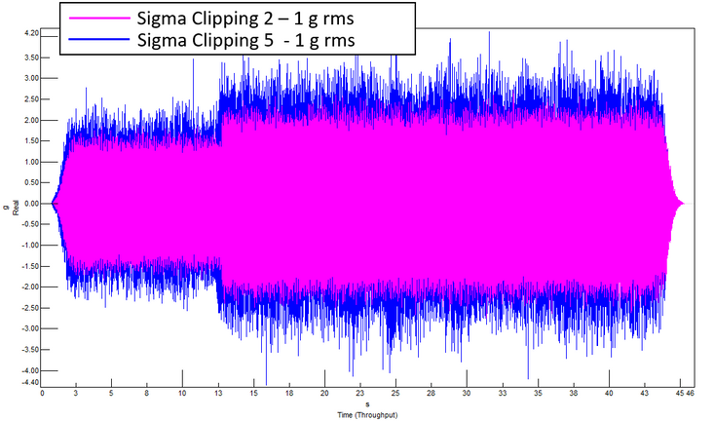
Our Capacities
Vibrational Analyses
Vibration analysis is a fundamental technique for diagnosing faults, optimising performance and ensuring the safety of machines, structures and vehicles. By measuring vibrations, it is possible to identify problems such as misalignment, looseness and wear.
Shaker

Slide 16
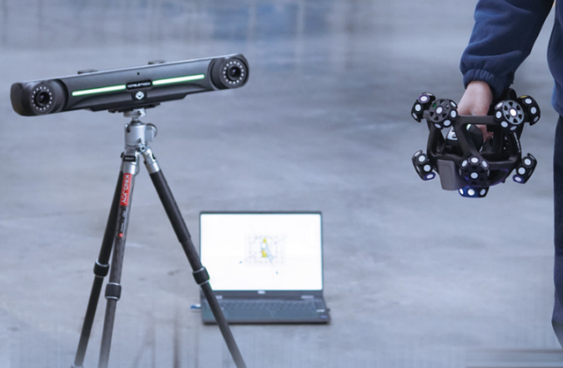
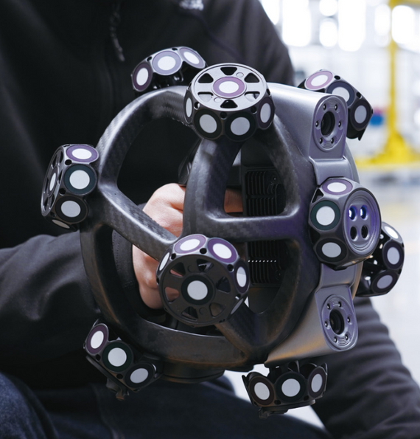
Our Capacities
Digitalisation
3D scanners are essential tools to accurately digitalise physical objects, enabling the creation of detailed three-dimensional models. In industry, these technologies are widely used for reverse engineering, quality control, rapid prototyping and dimensional inspection.

Slide 17
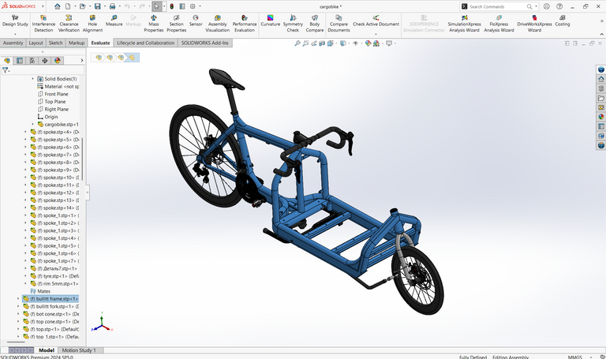
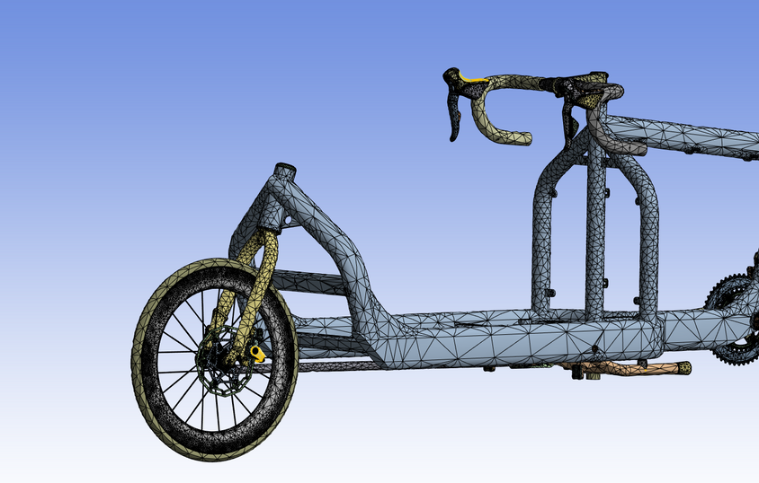
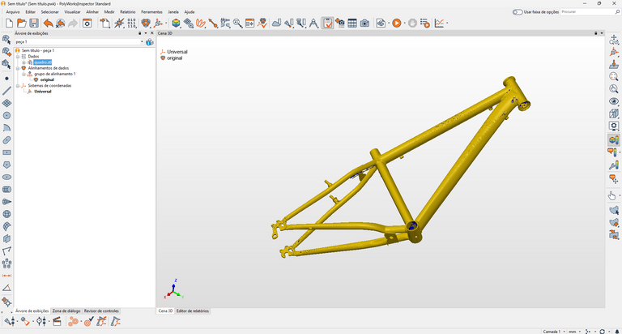
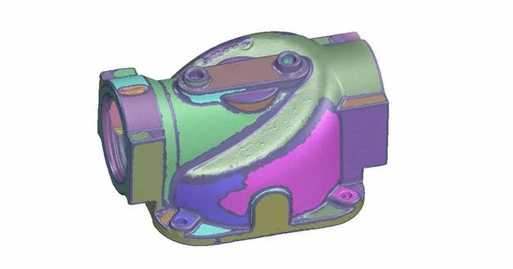
Our Capacities
Software
Our CAD (SolidWorks) and CAE (Ansys) software enables advanced design and performance simulation of engineered projects, optimising the entire workflow.
We also have reverse engineering software such as Geomagic for SolidWorks and metrology software such as PolyWorks, which allows us to analyse post-production or external parts.
SolidWorks
Ansys
Polyworks
Geomagic

Slide 18
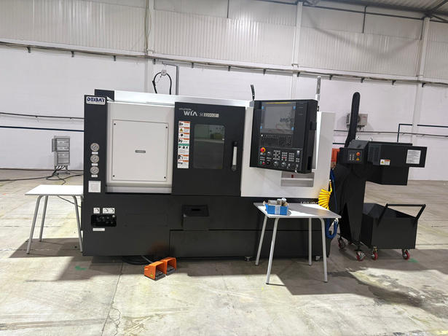
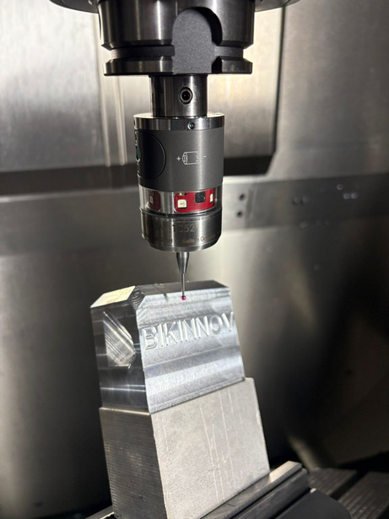
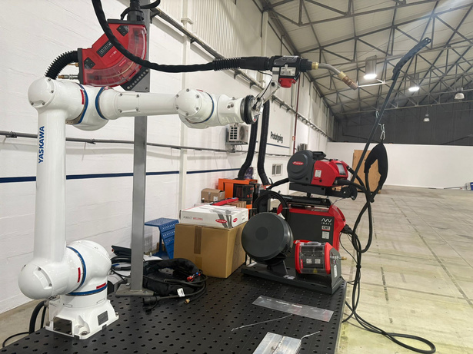
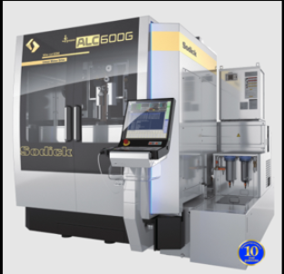
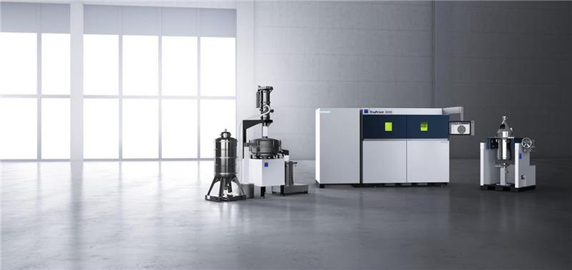
Our Capacities
Prototyping
The growing evolution of industry requires high-tech solutions that guarantee precision, efficiency and innovation in production processes.
Our Technology Center is equipped to provide all the necessary support, such as:
Production of prototypes;
Process study and optimisation
Training
CNC Lathe with
Y axi
5-axis CNC
Multi-process welding
Wire Erosion
Metal Additive Manufacturing

Slide 19


Our Capacities
Wind Tunnel and Crash Test
Studies into the safety and aerodynamics of the products developed
Crash Test
Wind Tunnel

Slide 20




Our Capacities
Mobility
Mobility Products
  Load and deformation control
  Data acquisition
  Parameterisation of the test system for flexibility
  Acquisition of industry benchmark solutions
  Innovative performance
Personal Protective Equipment
  Digitalisation
  Flexibility
  Capacity

Slide 21



Projects
Ongoing projects
Mobilising Agenda for Business Innovation in the Two-Wheels Sector
Mission Interface - Core funding for the TIC’s
Innovation Ecosystem for Knowledge and Technology Transfer

Slide 22


AM2R - Mobilising Agenda for Business Innovation in the Two-Wheels Sector
Project 43 - Study of New Aluminium Alloys for Two-Wheel Vehicles
Project 100 - Shared Capacity and Available Technology Management System
Project 111 - Technology and Innovation Centre for the two-wheel sector

Slide 23





Interface Mission - Core Funding for Technology and Innovation Centers
Action Line 1 - Study of the integration of soft mobility in the smart cities of the future;
Action Line 2 - Watch for new materials for soft mobility;
Action Line 3 - Monitoring Developments in the regulatory framework
Action Line 4 - Development of more eco-efficient manufacturing processes

Slide 24
Thank you!
César Coutinho
Cesar.Coutinho@bikinnov.pt
Ride the Future
www.bikinnov.pt
More Info: https://recuperarportugal.gov.pt/

